Slide 1
Developing Writing in English Language Teaching
Aim:
Understand the stages of writing development in English language learners.
Learn practical strategies to improve students’ writing skills.
Explore effective writing activities for different proficiency levels.
Gain insight into providing constructive feedback on student writing.

Slide 2
"Writing is a journey, not a destination"

Slide 3
Discussion questions:
    “What challenges do your students face in writing English?”
    “How do you currently teach writing in your classroom?”

Slide 4
Stages of Writing Development:
  Pre-Writing: Brainstorming, planning, organizing ideas.
  Drafting: Writing the first version without worrying about accuracy.
  Revising: Improving content and structure.
  Editing: Correcting grammar, spelling, and punctuation.

Slide 5
Strategies for Each Stage:
  Pre-Writing: Use graphic organizers (mind maps, storyboards).
  Drafting: Encourage free writing or journal entries.
  Revising: Peer reviews and collaborative discussions.
  Editing: Teach grammar in context, not isolation.
  Publishing: Display work in the classroom or on digital platforms.

Slide 6
Writing Activities for Different Levels
Beginner Level:
  Guided writing with sentence starters (e.g., “I like ___ because ___.”).
  Writing lists or labeling pictures.
Intermediate Level:
  Writing paragraphs with a clear topic sentence.
  Completing dialogues or writing informal emails.
Advanced Level:
  Essay writing (argumentative, descriptive, narrative).
  Writing reports, proposals, or opinion pieces.

Slide 7
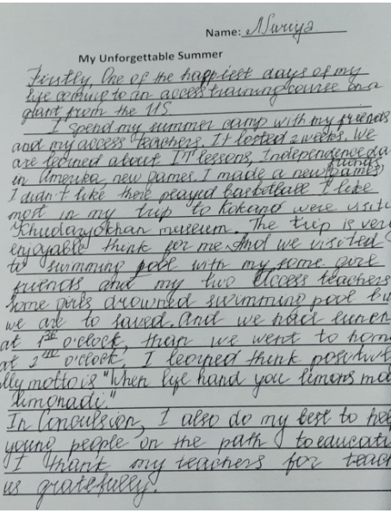
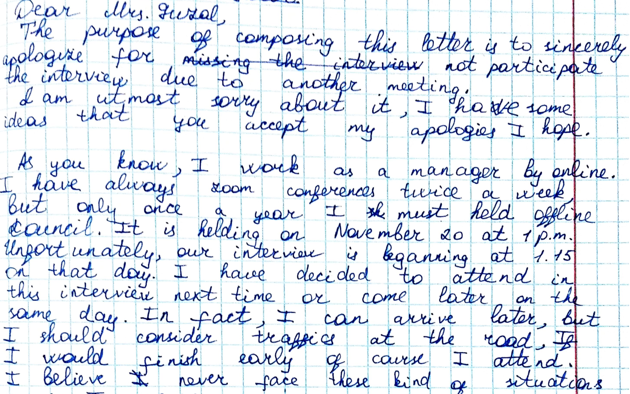
Examples

Slide 8
Providing Feedback on Writing
Best Practices for Feedback:
  Focus on one or two areas (e.g., grammar, organization).
  Use a feedback sandwich: positive note → suggestion → positive note.
  Encourage self-editing and peer correction.
Error Correction Techniques:
  Underline or highlight errors instead of correcting them.
  Use codes (e.g., "Sp" for spelling, "Gr" for grammar).

