Slide 1

1
4
5
6
8
Guess the thing based on the given parts of its picture.

Slide 2

1
2
3
4
5
6
7
8

Slide 3

1
2
3
4
5
6
7
8

Slide 4

1
2
3
4
5
6
7
8

Slide 5
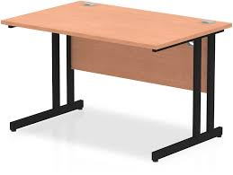
1
2
3
4
5
6
7
8

Slide 6

1
2
3
4
5
6
7
8

Slide 7
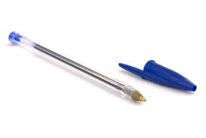
1
2
3
4
5
6
7
8

Slide 8
STEPS ON HOW TO INSERT PICTURE BEHIND THE TILES:
Paste or insert the picture you want to put.
Resize the picture. Make sure the picture covers the entire slide.
Then Right Click the picture and click send to back.
Play slideshow.

