Slide 1
Lesson Observation and Giving Feedback
Aim:
-Discuss the importance of Lesson observation.
- Give constructive feedback

Slide 2
What is the purpose of Lesson Observation
Go to the site and read the article How Lesson Observation Supports Great Teaching: A Detailed Guide​
https://www.irisconnect.com/uk/blog/how-to-make-lesson-observations-most-effective/

Slide 3
Purpose of the Lesson Observation
To provide constructive feedback for growth
To share best practices among educators
To ensure better learning outcomes for students
To enhance teaching effectiveness
To identify strengths and areas for improvement
To improve teaching practices

Slide 4
Types of Lesson Observations
Formal Observations: Conducted by school leaders or supervisors with structured evaluation.
Informal Observations: Peer observations or quick walkthroughs to offer general feedback.
Self-Observation: Teachers recording or reflecting on their lessons for self-improvement.

Slide 5
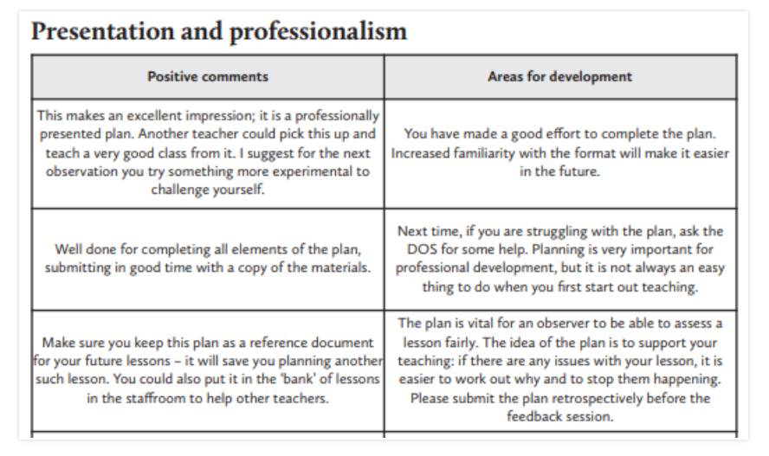

Slide 6
Effective Lesson Observation Techniques
Use an observation checklist or rubric
Focus on specific areas (lesson objectives, student engagement, questioning techniques, classroom management, differentiation, use of resources)
Take objective notes, avoiding personal bias
Observe student responses and engagement levels
Consider both verbal and non-verbal communication of the teacher

Slide 7
Steps for Giving Constructive Feedback
Start with Positives: Highlight what was done well.
Identify Areas for Improvement: Use specific examples from the lesson.
Offer Actionable Suggestions: Provide practical strategies for improvement.
Encourage Reflection: Ask the teacher about their perspective on the lesson.
End on an Encouraging Note: Reinforce strengths and growth mindset.

Slide 8
The Feedback Sandwich Approach
Positive Feedback: Start with strengths.
Constructive Criticism: Address areas for improvement with supportive suggestions.
Encouragement: End on a motivating note.

Slide 9
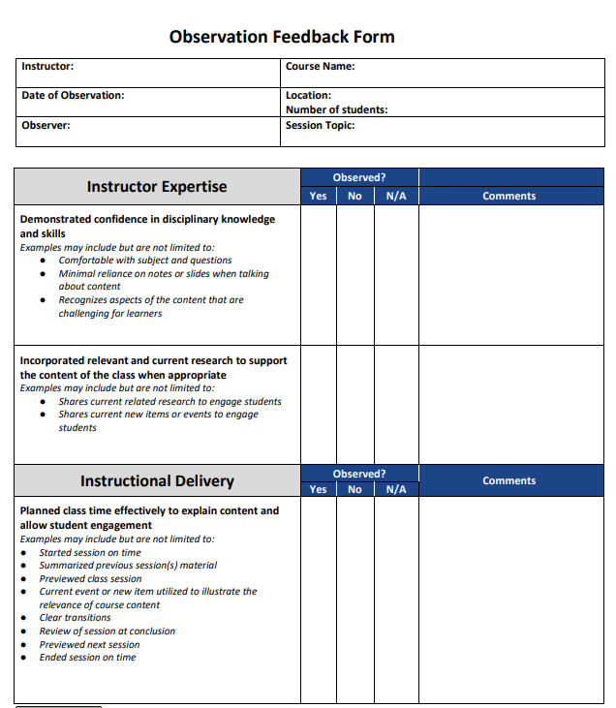

Slide 10
Test
What is an effective way to give feedback after an observation?
A) Only point out what went wrong
B) Give vague suggestions
C) Use specific examples and offer constructive suggestions
D) Avoid discussing weaknesses

Slide 11
Test
Why is it important to use an observation checklist?
A) To ensure consistency and focus on key areas
B) To make the observation process longer
C) To record everything happening in the class
D) To rank teachers based on performance

Slide 12
True/False
Lesson observation is only useful for new teachers.

Slide 13
Test
Which of the following is NOT a type of lesson observation?
A) Formal observation
B) Informal observation
C) Peer observation
D) Student observation

