Slide 1
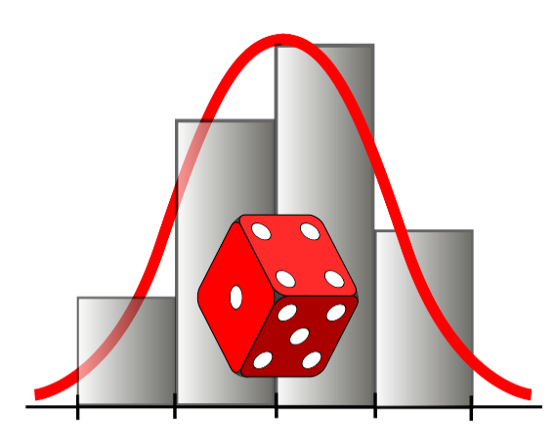
MATEMATIKA
Ehtimolliklarga doir aralash masalalar
O‘qituvchi: Axmedova Zulnuraxon

Slide 2
MATEMATIKA
Ehtimolliklarga oid turli ko‘rinishdagi masalalarni yechish
Ehtimolliklarga oid masalalarni yechishda ko‘rgazmalilik

Slide 3

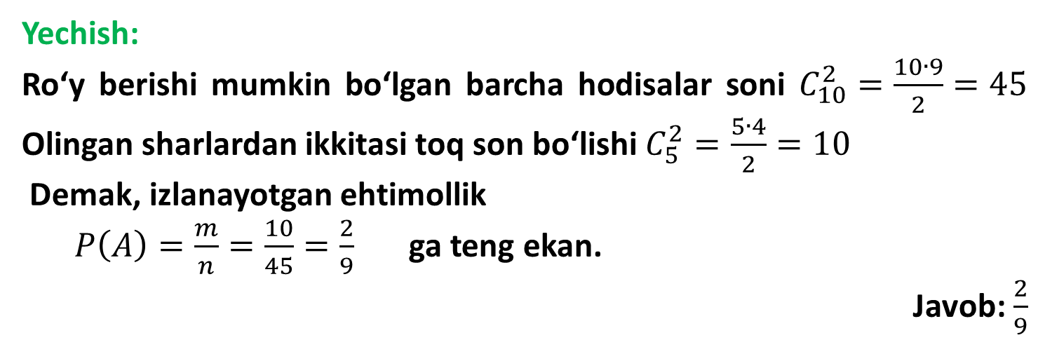
MATEMATIKA
1-masala. Tajribada tanga uch marta tashlanayapti. Tangalarning kamida ikkitasi “raqam” tomoni bilan tushishi ehtimolligini toping
Yechish:
Ro‘y berishi mumkin bo‘lgan barcha hodisalar soni $C_{10}^{2}=\frac{10∙9}{2}=45$ Olingan sharlardan ikkitasi toq son bo‘lishi $C_{5}^{2}=\frac{5∙4}{2}=10$
Demak, izlanayotgan ehtimollik
$P\left(A\right)=\frac{m}{n}=\frac{10}{45}=\frac{2}{9}$ ga teng ekan.
Javob: $\frac{2}{9}$

Slide 4
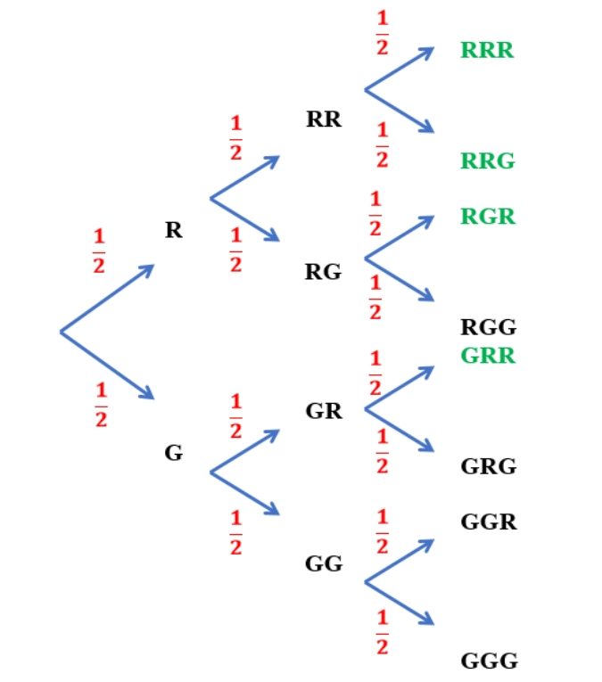

Yechish:

Slide 5

MATEMATIKA
2-masala. Merganning nishonga tekkizish ehtimoli 0,8 ga teng. U nishonga 3 marta o‘q uzganda barcha o‘qlari nishonga tegishining ehtimolligini toping.

Slide 6
MATEMATIKA
Yechish:
A = {1- o‘qning nishonga tegishi}
B = {2- o‘qning nishonga tegishi}
C = {3- o‘qning nishonga tegishi}
A, B, C hodisalar o‘zaro bog‘liqsiz.
P(A∩B∩C) = P(A) ‧ P(B) ‧ P(C) = 0,8 ‧ 0,8 ‧ 0,8 = 0,512
Javob: 0,512

Slide 7
MATEMATIKA
3-masala. Mergan 5 marta nishonga o‘q otayapti. O‘qning nishonga tegish ehtimolligi 0,8 ga teng. Merganning dastlabki uchta otishda o‘q nishonga tegishi va keyingi ikki otishda esa nishonga tegmasligi ehtimolligini toping.

Slide 8
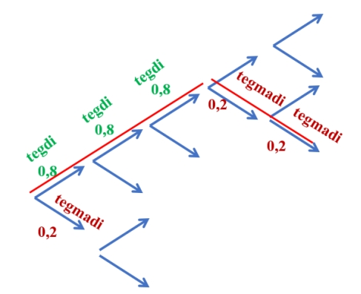
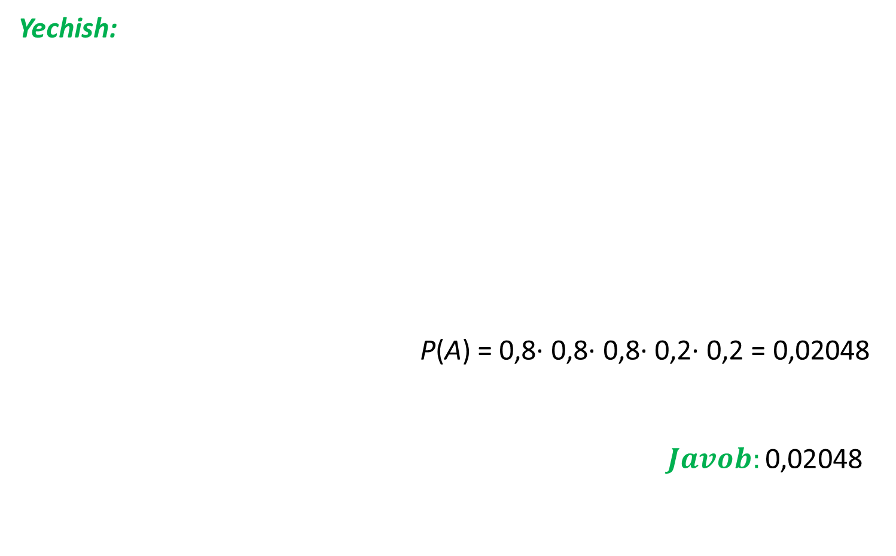
Yechish:
P(A) = 0,8· 0,8· 0,8· 0,2· 0,2 = 0,02048
$$Javob:\text{0,02048 }$$

Slide 9
MATEMATIKA
4-masala. Korxonaga favqulodda hodisa ro‘y berganda xabar beradigan, bir-biridan mustaqil ishlovchi 2 ta asbob o‘rnatilgan. Favqulodda hodisa ro‘y berganda birinchi asbobning ishlash ehtimoli 0,85 ga, ikkinchisi uchun bu ehtimollik 0,8 ga teng. Favqulodda hodisa ro‘y berganda faqat bitta asbobning ishlash ehtimolini toping.

Slide 10
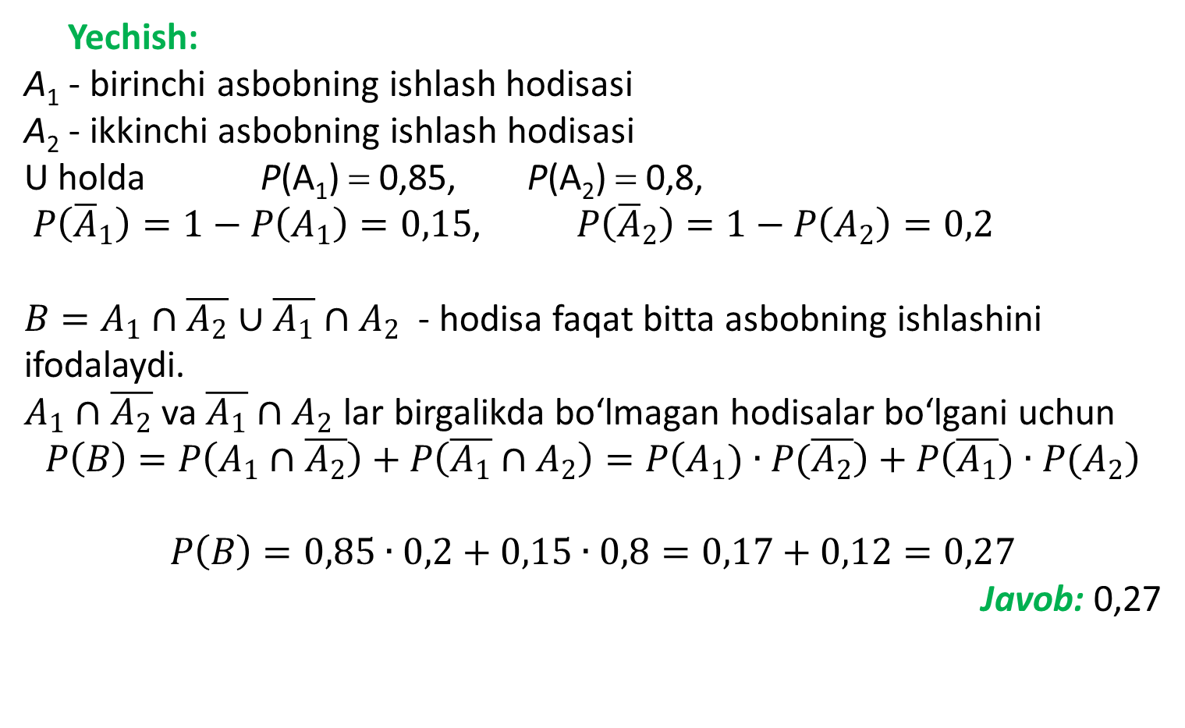
Yechish:
A₁ - birinchi asbobning ishlash hodisasi
A₂ - ikkinchi asbobning ishlash hodisasi
U holda P(A₁) = 0,85, P(A₂) = 0,8,
$P\left({\overline{A}}_{1}\right)=1−P\left(A_{1}\right)=0,15$, $P\left({\overline{A}}_{2}\right)=1−P\left(A_{2}\right)=0,2$
$B=A_{1}∩\overline{A_{2}}∪\overline{A_{1}}∩A_{2}$- hodisa faqat bitta asbobning ishlashini ifodalaydi.
$A_{1}∩\overline{A_{2}}$ va $\overline{A_{1}}∩A_{2}$ lar birgalikda bo‘lmagan hodisalar bo‘lgani uchun
$$P\left(B\right)=P\left(A_{1}∩\overline{A_{2}}\right)+P\left(\overline{A_{1}}{∩A}_{2}\right)=P\left(A_{1})∙P(\overline{A_{2}}\right)+P\left(\overline{A_{1}})∙P(A_{2}\right)$$
$$P\left(B\right)=0,85∙0,2+0,15∙0,8=0,17+0,12=0,27$$
Javob: 0,27

Slide 11
5-masala. 4 ta mergan bir – biriga bogʻliq boʻlmagan holda bir martadan oʻq uzishmoqda. Har birining nishonga tegish ehtimolligi 0,25 ga teng. Nishonga
a) 1 ta oʻqning nishonga tegishi;
b) 2 ta oʻqning nishonga tegishi;
c) 3 ta oʻqning nishonga tegishi;
d) 4 ta oʻqning nishonga tegishi;
e) birorta ham oʻqning nishonga tegmasligi hodisalarining ehtimolliklarini toping.

Slide 12
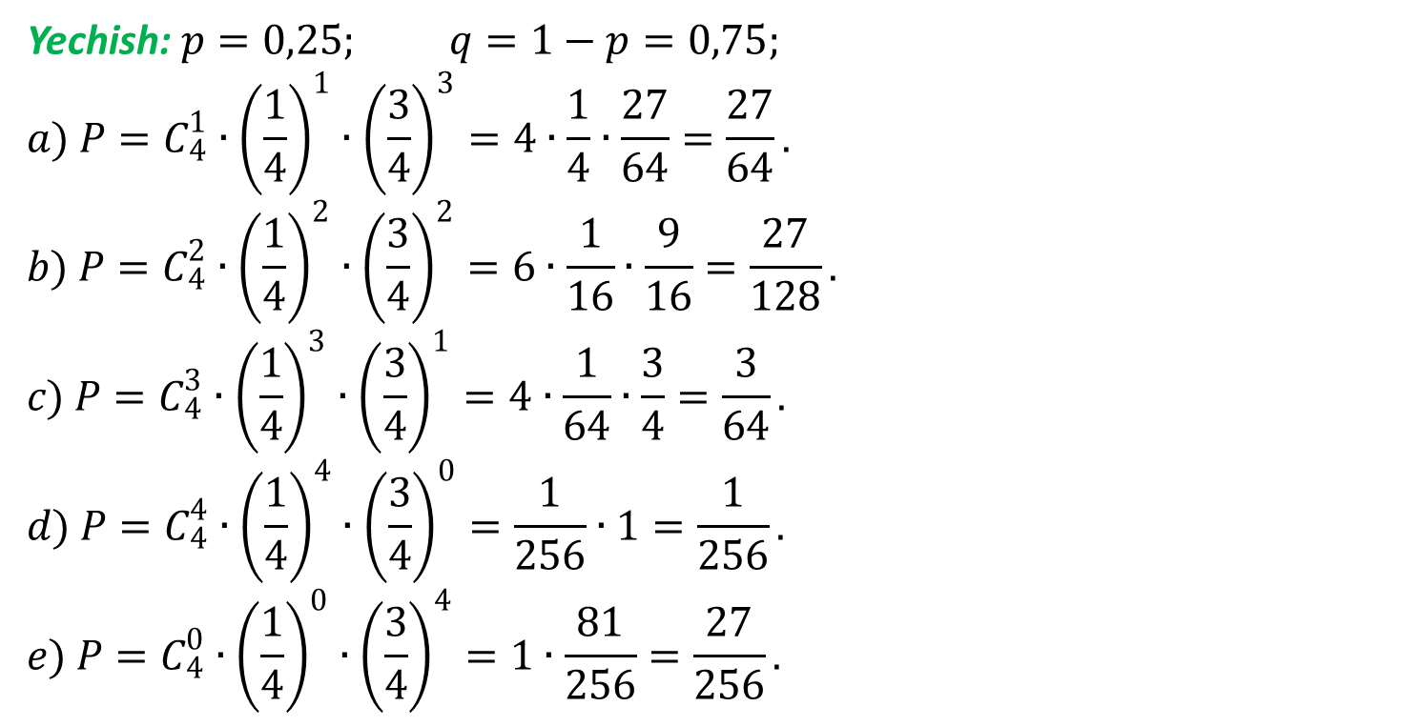
Yechish: $p=0,25; q=1−p=0,75;$
$$a) P=C_{4}^{1}∙{\left(\frac{1}{4}\right)}^{1}∙{\left(\frac{3}{4}\right)}^{3}=4∙\frac{1}{4}∙\frac{27}{64}=\frac{27}{64}.$$
$$b) P=C_{4}^{2}∙{\left(\frac{1}{4}\right)}^{2}∙{\left(\frac{3}{4}\right)}^{2}=6∙\frac{1}{16}∙\frac{9}{16}=\frac{27}{128}.$$
$$c) P=C_{4}^{3}∙{\left(\frac{1}{4}\right)}^{3}∙{\left(\frac{3}{4}\right)}^{1}=4∙\frac{1}{64}∙\frac{3}{4}=\frac{3}{64}.$$
$$d) P=C_{4}^{4}∙{\left(\frac{1}{4}\right)}^{4}∙{\left(\frac{3}{4}\right)}^{0}=\frac{1}{256}∙1=\frac{1}{256}.$$
$$e) P=C_{4}^{0}∙{\left(\frac{1}{4}\right)}^{0}∙{\left(\frac{3}{4}\right)}^{4}=1∙\frac{81}{256}=\frac{27}{256}.$$

Slide 13
MATEMATIKA
6-masala. Uskuna 10 ta qismdan iborat. Har bir qismning ishdan chiqishi ehtimolligi q ga teng. Qismlar oʻzaro bogʻliqsiz holda ishdan chiqishi mumkin. Quyidagi hodisalarning ehtimolliklarini toping:
a) ikkita qismning ishdan chiqishi;
b) kamida ikkita qismning ishdan chiqishi;
c) kamida bitta qismning ishdan chiqishi.

Slide 14
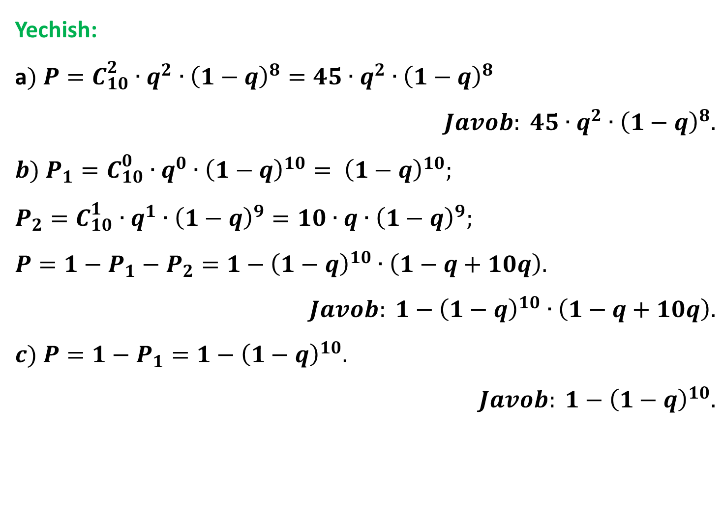
Yechish:
а$) P=C_{10}^{2}∙q^{2}∙{\left(1−q\right)}^{8}=45∙q^{2}∙{\left(1−q\right)}^{8}$
$$Javob: 45∙q^{2}∙{\left(1−q\right)}^{8}.$$
$$b) P_{1}=C_{10}^{0}∙q^{0}∙{\left(1−q\right)}^{10}= {\left(1−q\right)}^{10};$$
$$P_{2}=C_{10}^{1}∙q^{1}∙{\left(1−q\right)}^{9}=10∙q∙{\left(1−q\right)}^{9};$$
$$P=1−P_{1}−P_{2}=1−{\left(1−q\right)}^{10}∙\left(1−q+10q\right).$$
$$Javob: 1−{\left(1−q\right)}^{10}∙\left(1−q+10q\right).$$
$$c) P=1−P_{1}=1−{\left(1−q\right)}^{10}.$$
$$Javob: 1−{\left(1−q\right)}^{10}.$$

Slide 15
MATEMATIKA
E’TIBORINGIZ UCHUN RAHMAT!

