Slide 1
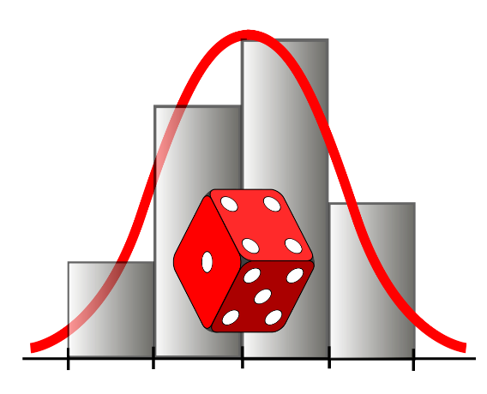
MATEMATIKA
Ehtimolliklarni qo‘shish qoidasi
O‘qituvchi: Axmedova Zulnuraxon

Slide 2
MATEMATIKA
Birgalikda bo‘lmagan hodisalar;
Ehtimolliklarni qo‘shish qoidasi va ularning xossalari;
Hodisalarning ehtimolliklarni hisoblash usullari.

Slide 3

MATEMATIKA
Agar A va B hodisalarni har ikkalasining ham ro‘y berishiga qulaylik tug‘diradigan (maqbul) elementar hodisalar mavjud bo‘lmasa, bu hodisalar bir vaqtda sodir bo‘la olmaydi va birgalikda bo‘lmagan hodisalar deb ataladi.
A
B
A$∩B=∅$P(A$∩B$)$=0$

Slide 4
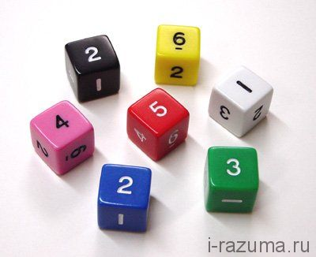
MATEMATIKA
Yoqlariga 1 dan 6 gacha raqamlar yozilgan kub tashlandi.
A= {juft sonning tushishi}
B= {toq sonning tushishi}

Slide 5
O‘zaro birgalikda bo‘lgan ikkita hodisadan kamida bittasining ro‘y berish ehtimoli bu hodisalarning ehtimollari yig‘indisidan ularning birgalikda ro‘y berish ehtimolini ayirilganiga teng
P(A+B)=P(A)+P(B)-P(AB)
P(A+B)=P(A)+P(B)
Ikkita birgalikda bo‘lmagan hodisadan istalgan birining ro‘y berish ehtimoli bu hodisalar ehtimollarining yig‘indisiga teng

Slide 6
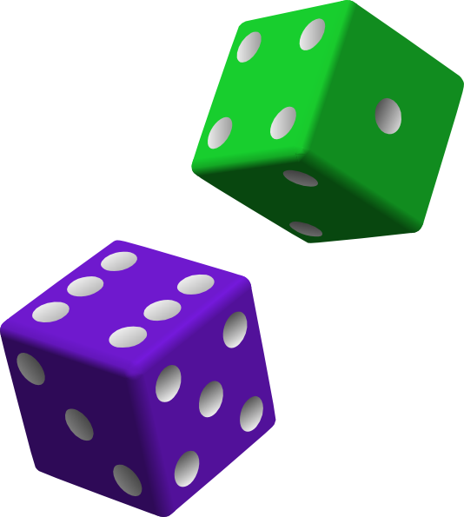
MATEMATIKA
1-masala. O‘yin toshi ikki marta ketma-ket tashlandi.
A={birinchi bor tashlanganda ikkinchi bor tashlanganga qaraganda katta son tushishi}
B={birinchi bor tashlanganda ikkinchi bor tashlanganga qaraganda kichik son tushishi}
A va B hodisalar birlashmasining ehtimolini toping.

Slide 7
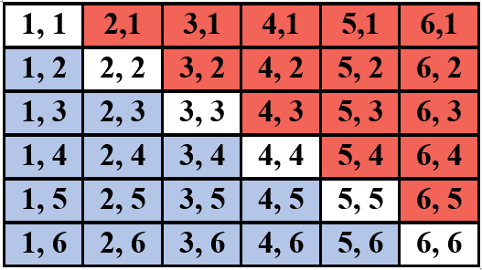
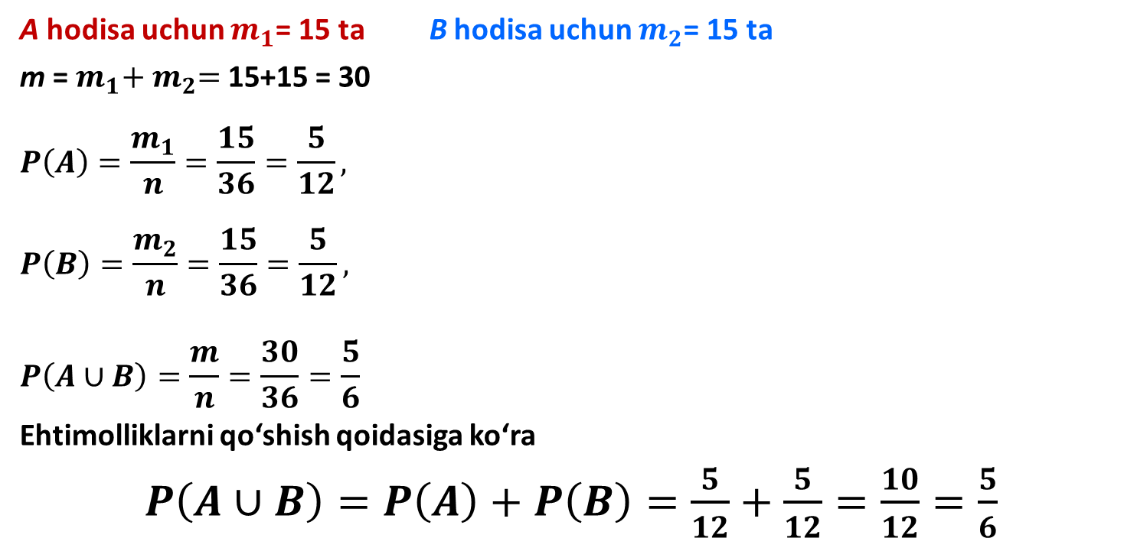
MATEMATIKA
A hodisa uchun $m_{1}$= 15 ta B hodisa uchun $m_{2}$= 15 ta
m = $m_{1}{+ m}_{2}=$ 15+15 = 30
$$P\left(A\right)=\frac{m_{1}}{n}=\frac{15}{36}=\frac{5}{12},$$
$$P\left(B\right)=\frac{m_{2}}{n}=\frac{15}{36}=\frac{5}{12},$$
$$P\left(A∪B\right)=\frac{m}{n}=\frac{30}{36}=\frac{5}{6}$$
Ehtimolliklarni qo‘shish qoidasiga ko‘ra
$P\left(A∪B\right)=P\left(A\right)+P\left(B\right)=\frac{5}{12}+\frac{5}{12}=\frac{10}{12}=\frac{5}{6}$

Slide 8

MATEMATIKA
2-masala. Ikkita o‘yin toshi tashlandi.
A={birinchi o‘yin toshida 4 dan kam son tushishi}
B={ikkinchi toshda 2 dan kam son tushishi}
A va B hodisalar birlashmasining ehtimolini toping.

Slide 9
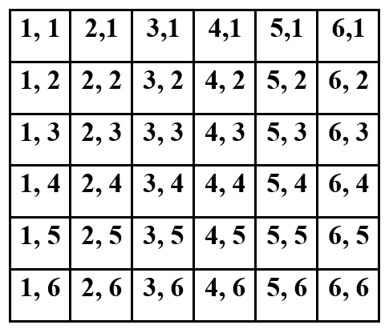
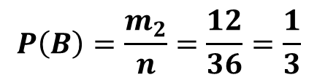
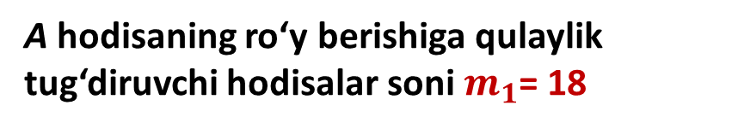
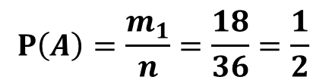

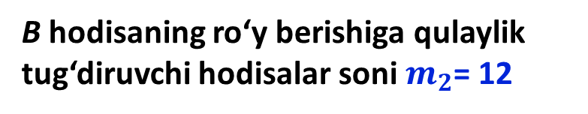
MATEMATIKA
A hodisaning ro‘y berishiga qulaylik tug‘diruvchi hodisalar soni $m_{1}$= 18
$$P\left(A\right)=\frac{m_{1}}{n}=\frac{18}{36}=\frac{1}{2}$$
B hodisaning ro‘y berishiga qulaylik tug‘diruvchi hodisalar soni $m_{2}$= 12
$$P\left(B\right)=\frac{m_{2}}{n}=\frac{12}{36}=\frac{1}{3}$$
A$∪B$ uchun qulaylik tug‘diruvchi elementar hodisalar soni m = 24
$$P\left(A ∪B\right)=\frac{m}{n}=\frac{24}{36}=\frac{2}{3}$$

Slide 10

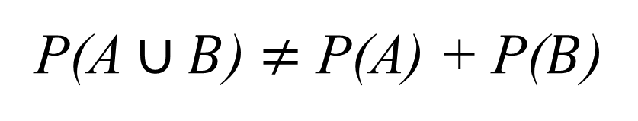
MATEMATIKA
P(A$∪B$) $≠$ P(A) + P($B$)
A va B hodisalar birgalikda, ya’ni ularning keshishmasi bo‘sh to‘plam emas.

Slide 11
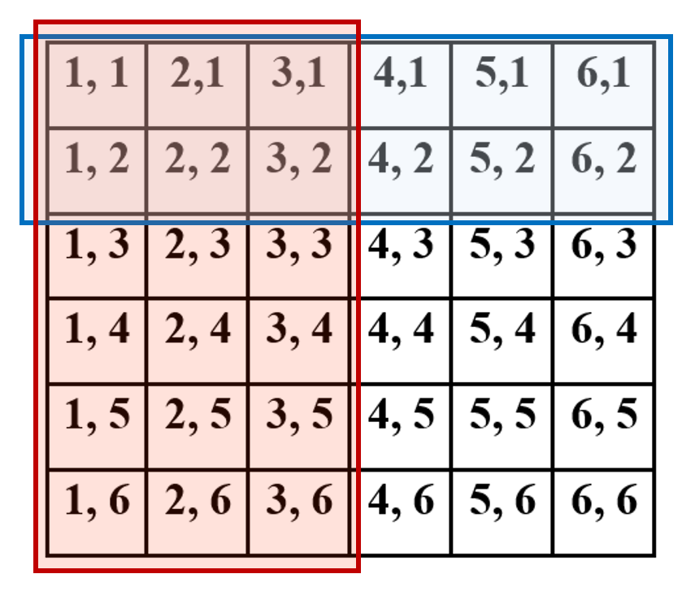
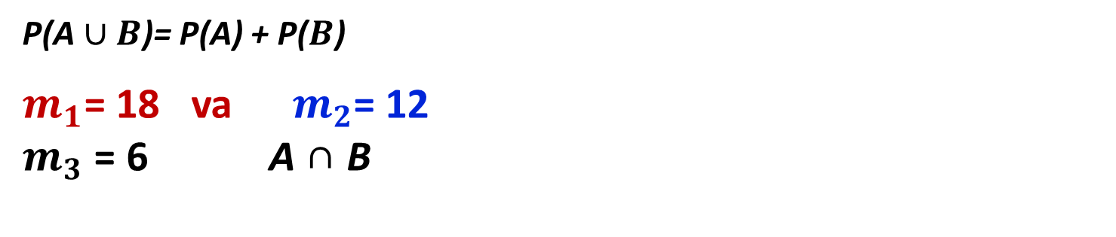
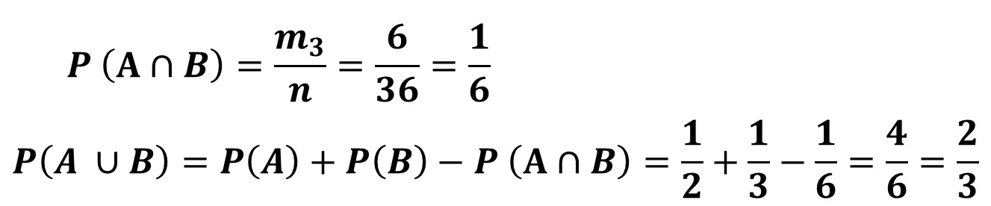

MATEMATIKA
P(A$∪B$)= P(A) + P($B$)
$m_{1}$= 18 va $m_{2}$= 12
$m_{3}$ = 6 A ∩ B
P(A$∪B$) $=$ P(A) + P($B$) – P (A∩B)
$$P \left(A∩B\right)=\frac{m_{3}}{n}=\frac{6}{36}=\frac{1}{6}$$
$$P\left(A ∪B\right)=P\left(A\right)+P\left(B\right)−P \left(A∩B\right)=\frac{1}{2}+\frac{1}{3}−\frac{1}{6}=\frac{4}{6}=\frac{2}{3}$$

Slide 12
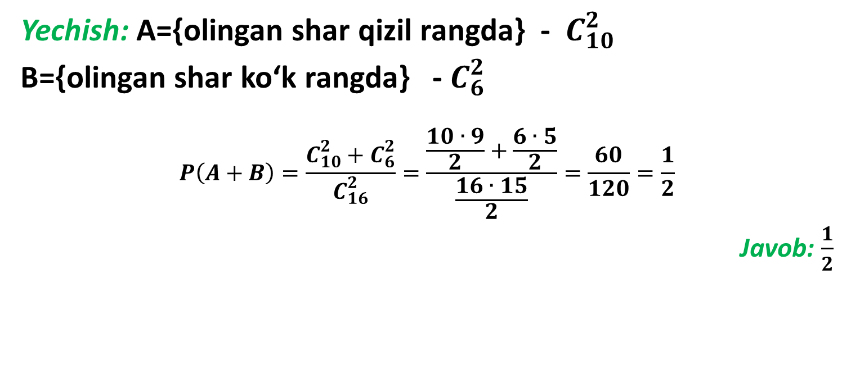

MATEMATIKA
3-masala. Yashikda 10 ta qizil va 6 ta ko‘k shar bor. Tavakkaliga 2 ta shar olindi. Olingan ikkala sharning bir xil rangli bo‘lish ehtimolini toping.
Yechish: A={olingan shar qizil rangda} - $C_{10}^{2}$
B={olingan shar ko‘k rangda} - $C_{6}^{2}$
$$P\left(A+B\right)=\frac{C_{10}^{2}+C_{6}^{2}}{C_{16}^{2}}=\frac{\frac{10∙9}{2}+\frac{6∙5}{2}}{\frac{16∙15}{2}}=\frac{60}{120}=\frac{1}{2}$$
Javob: $\frac{1}{2}$
$$C_{16}^{2}$$

Slide 13

MATEMATIKA
4-masala. 50 ta sharcha 1 dan 50 gacha raqamlanib, idishga solingan. Tavakkaliga olingan sharcha raqamining 3 ga yoki 19 ga karrali bo‘lish ehtimolini toping.

Slide 14
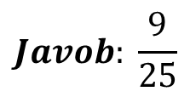
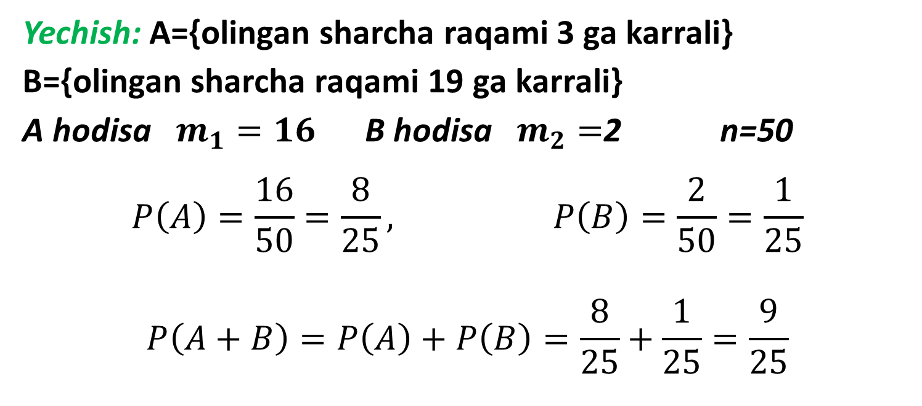
MATEMATIKA
Yechish: A={olingan sharcha raqami 3 ga karrali}
B={olingan sharcha raqami 19 ga karrali}
A hodisa $m_{1}=16$ B hodisa $m_{2}=$2 n=50
$$P\left(A\right)=\frac{16}{50}=\frac{8}{25}, P\left(B\right)=\frac{2}{50}=\frac{1}{25}$$
$$P\left(A+B\right)=P\left(A\right)+P\left(B\right)=\frac{8}{25}+\frac{1}{25}=\frac{9}{25}$$
$$Javob: \frac{9}{25}$$

Slide 15
MATEMATIKA
5-masala. Qutida 40 ta shar bor, ulardan 20 tasi ko‘k, 15 tasi qora va 5 tasi oq. Tavakkal olingan sharning rangli bo‘lish ehtimolligini toping.

Slide 16
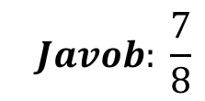
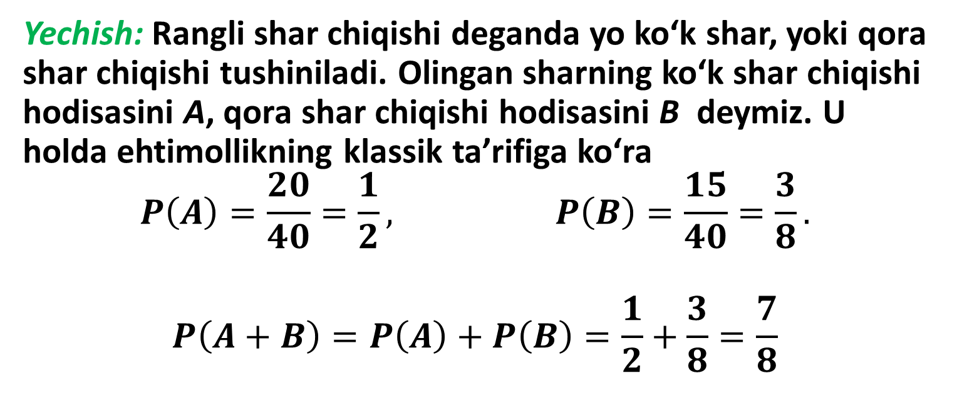
MATEMATIKA
Yechish: Rangli shar chiqishi deganda yo ko‘k shar, yoki qora shar chiqishi tushiniladi. Olingan sharning ko‘k shar chiqishi hodisasini A, qora shar chiqishi hodisasini B deymiz. U holda ehtimollikning klassik ta’rifiga ko‘ra
$$P\left(A\right)=\frac{20}{40}=\frac{1}{2}, P\left(B\right)=\frac{15}{40}=\frac{3}{8}.$$
$$P\left(A+B\right)=P\left(A\right)+P\left(B\right)=\frac{1}{2}+\frac{3}{8}=\frac{7}{8}$$
$$Javob: \frac{7}{8}$$

Slide 17
MATEMATIKA
6-masala. Ikki ovchi bo‘riga qarata bittadan o‘q uzishdi. Birinchi ovchining bo‘riga o‘qni tekkizish ehtimoli 0,7 ga, ikkinchisiniki esa 0,8 ga teng. Hech bo‘lmaganda bitta o‘qning bo‘riga tegish ehtimolini toping.
Yechish: A={birinchi ovchining bo‘riga o‘qni tekkizishi}
B ={ikkinchi ovchining bo‘riga o‘qni tekkizishi}
P(A+B)=P(A)+P(B)-P(AB)= P(A)+P(B)-P(A)∙P(B)= 0,7+0,8-0,7∙0,8=0,94
Javob: 0,94

Slide 18
Matematika
MATEMATIKA
E’TIBORINGIZ UCHUN RAHMAT!

