Slide 1
Overview of Assessments
Aim: PWBAT
Explore types and tools of assessment
Get informed with the International Assessments
Have a practice of Cambridge Exam

Slide 2
Types of Assessment:
Formative & Summative, self assessment, peer assessment
Formative Assessment: to see the language learning process, to find out about our students knowledge on learning, to clarify where they are and what kind of help they need; (Ex: do some activities, ask questions…
Summative Assessment: to get the final result (at the end of the course, State exams, getting certificates…)

Slide 3
Tools of Assessment
Activities | Me | My friend
Swimming | V
Drawing |  | V
Riding a bike | V | V
Checklist
Rubrics (www.rubistar)
Example of Checklist and
Rubrics
 | 1 | 2 | 3
Organization | No topic sentence | Topic sentence, missing of some supportive details | Well planned, supportive details
Content | Out of topic | Few good ideas | To the topic

Slide 4
What’s PIRLS?
The Progress in International Reading Literacy Study (PIRLS) is an international assessment and research project designed to measure reading achievement at the fourth-grade level, as well as school and teacher practices related to instruction. Fourth-grade students complete a reading assessment and questionnaire that addresses students’ attitudes toward reading and their reading habits. In addition, questionnaires are given to students’ teachers and school principals to gather information about students’ school experiences in developing reading literacy. Since 2001, PIRLS has been administered every 5 years, with the United States participating in all past assessments. PIRLS is sponsored by the International Association for the Evaluation of Educational Achievement (IEA) and conducted in the United States by the National Center for Education Statistics (NCES).

Slide 5
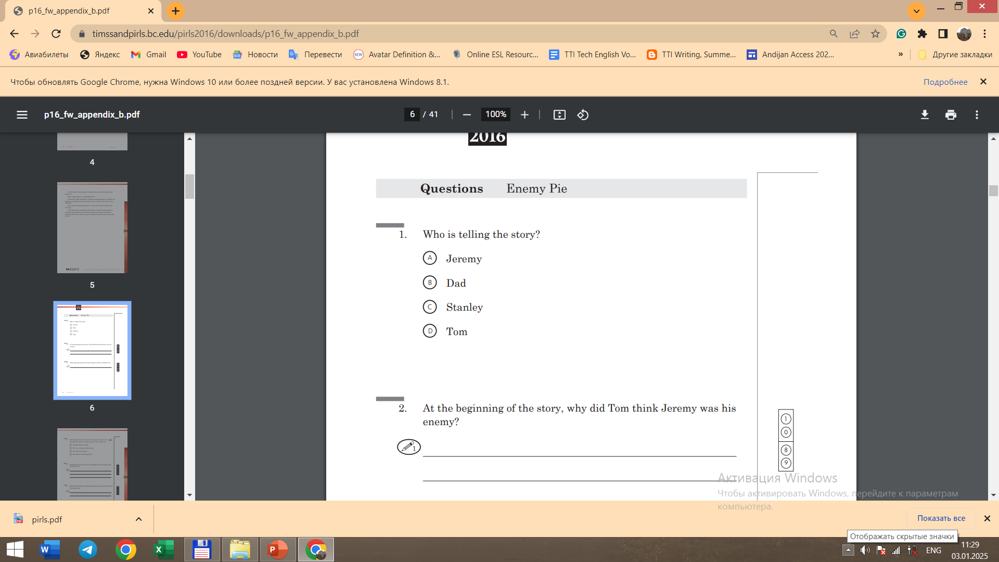
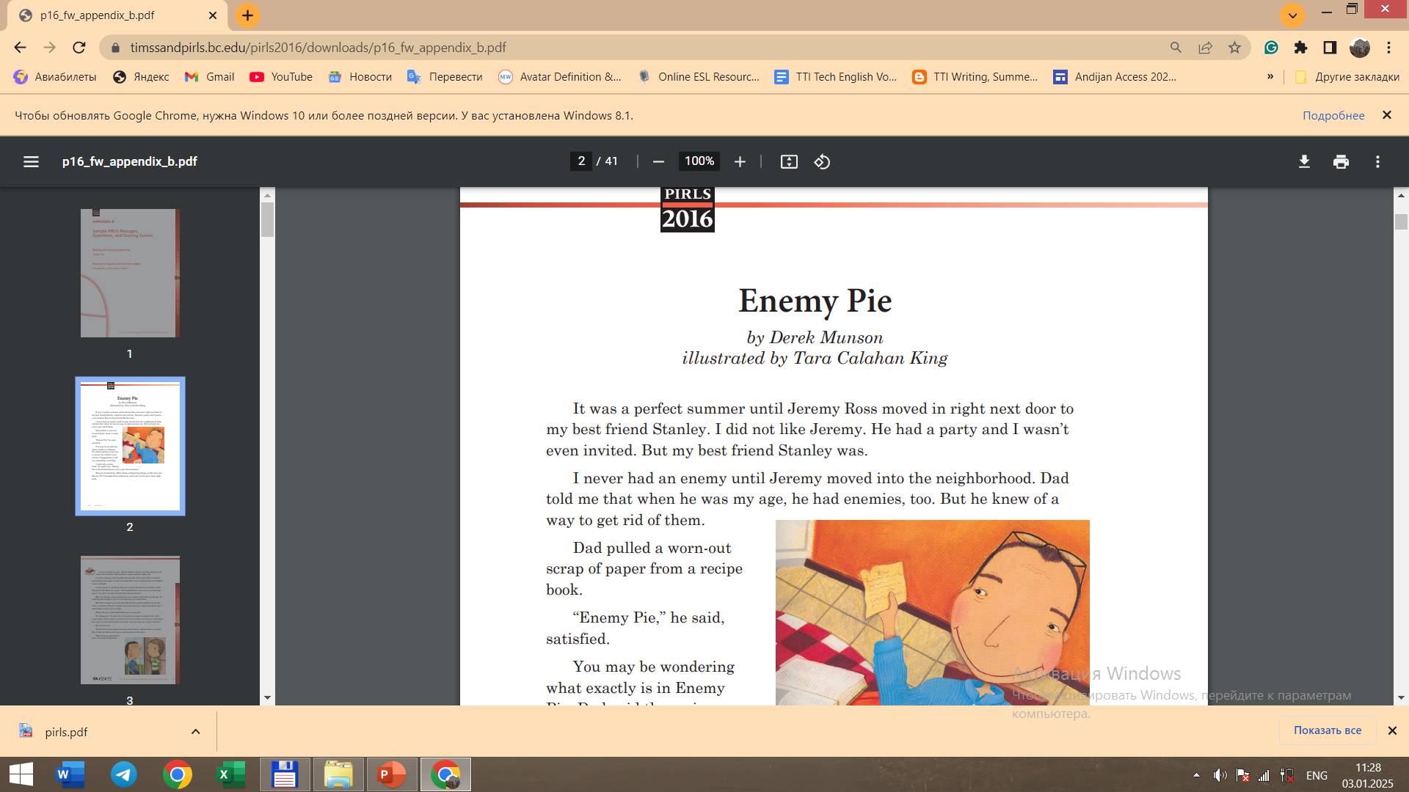
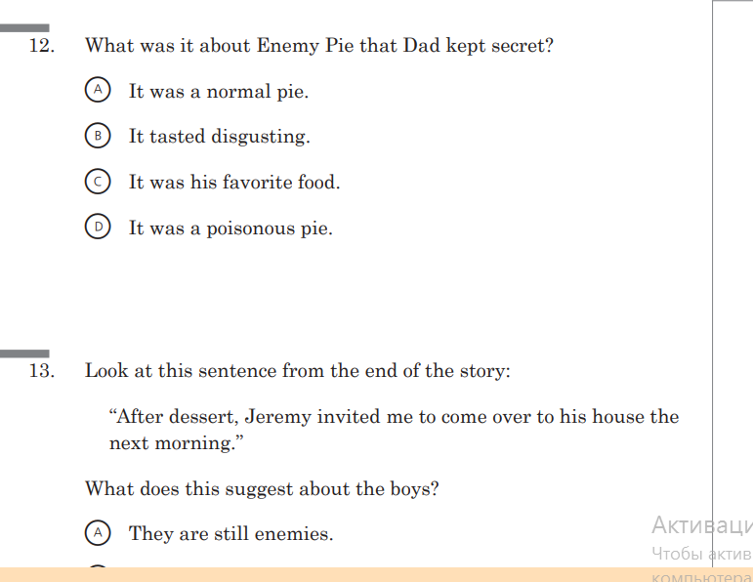
Examples for PIRLS

Slide 6
What is PISA?
The Programme for International Student Assessment (PISA) is a worldwide study by the Organisation for Economic Co-operation and Development (OECD) in member and non-member nations intended to evaluate educational systems by measuring 15-year-old school pupils' scholastic performance on mathematics, science, and reading.^{[1]} It was first performed in 2000 and then repeated every three years. Its aim is to provide comparable data with a view to enabling countries to improve their education policies and outcomes. It measures problem solving and cognition.

Slide 7
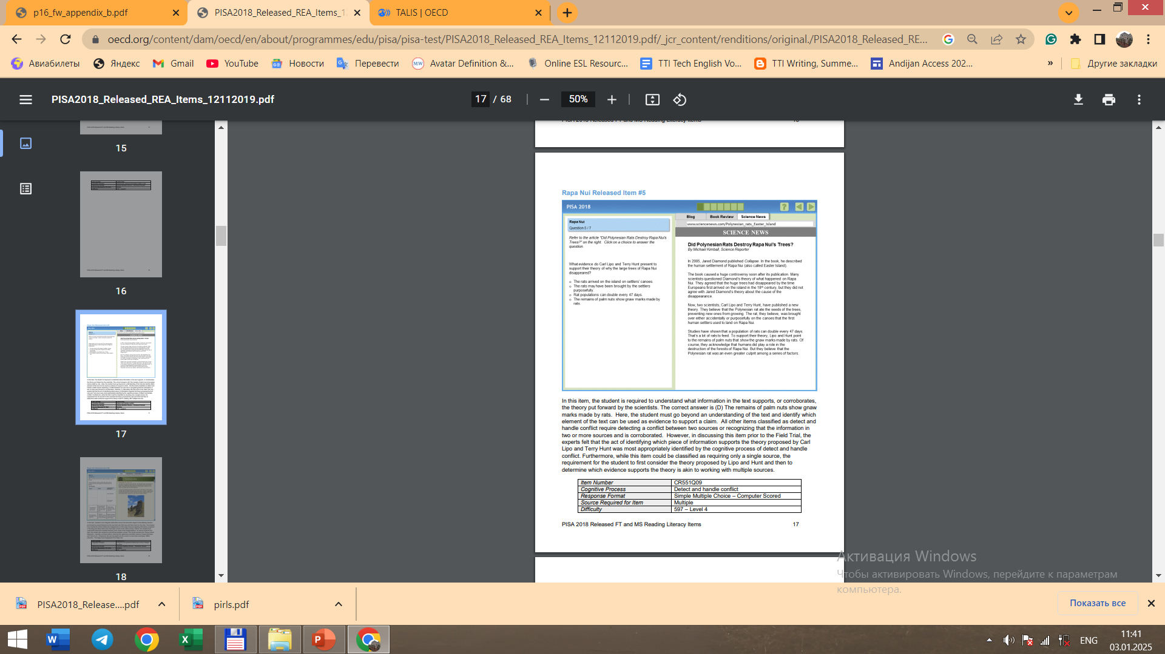
Example for PISA

Slide 8
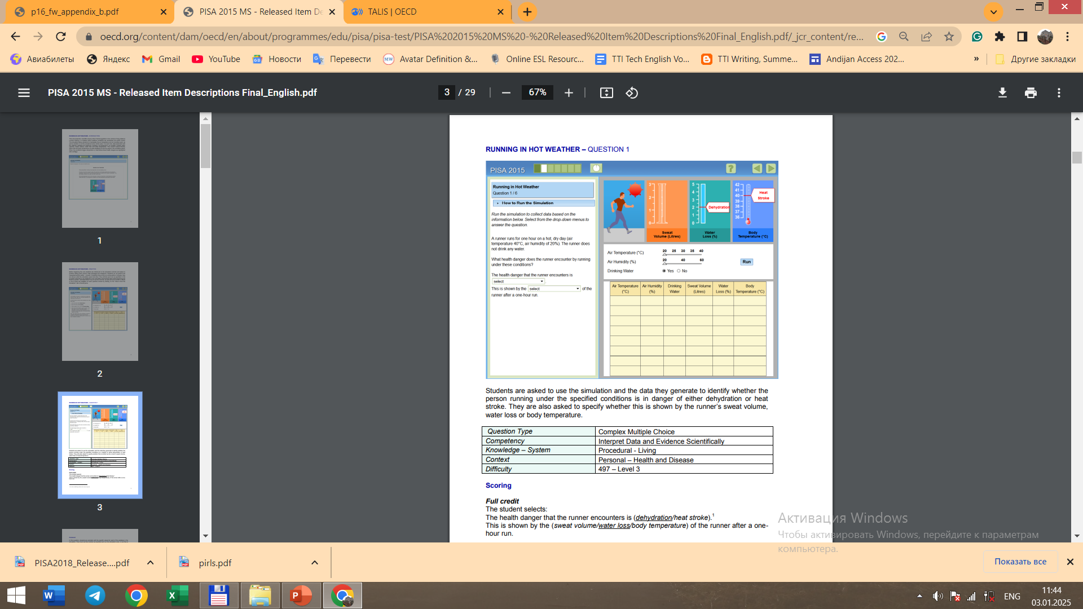

Slide 9
What is TALIS?
TALIS - the Teaching and Learning International Survey - is the world's largest international survey about teachers and school leaders.

Slide 10
What is Cambridge Assessment?
Cambridge Assessment English or Cambridge English develops and produces Cambridge English Qualifications and the International English Language Testing System (IELTS). The organisation contributed to the development of the Common European Framework of Reference for Languages (CEFR), the standard used around the world to benchmark language skills,^{[2]} and its qualifications and tests are aligned with CEFR levels.^{[3]}
Cambridge Assessment English is part of Cambridge Assessment, a non-teaching department of the University of Cambridge^{[4]} which merged with Cambridge University Press to form Cambridge University Press & Assessment in August 2021.^{[5]}

Slide 11
^{[8][9]}
Pre A1 Starters
A1 Movers
A2 Flyers
A2 Key for Schools
B1 Preliminary for Schools
B2 First for Schools
C1 Advanced
C2 Proficiency

Slide 12
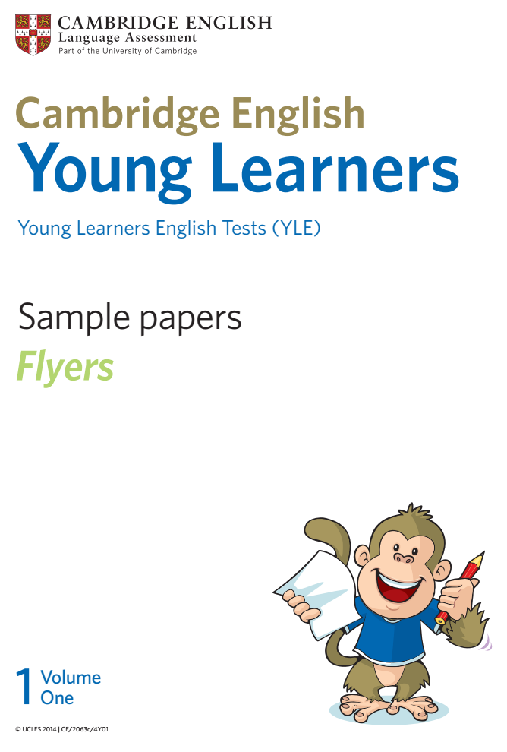
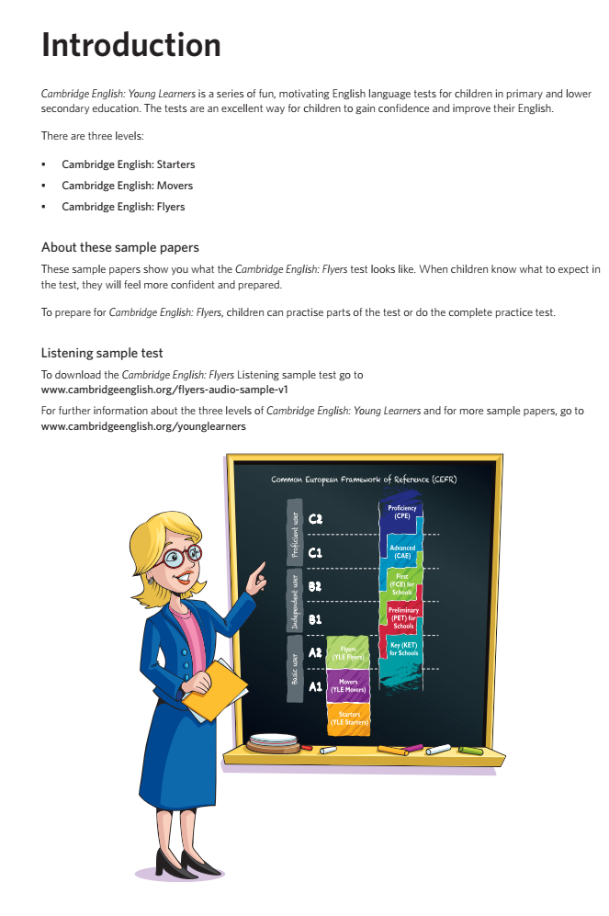
Example

Slide 13
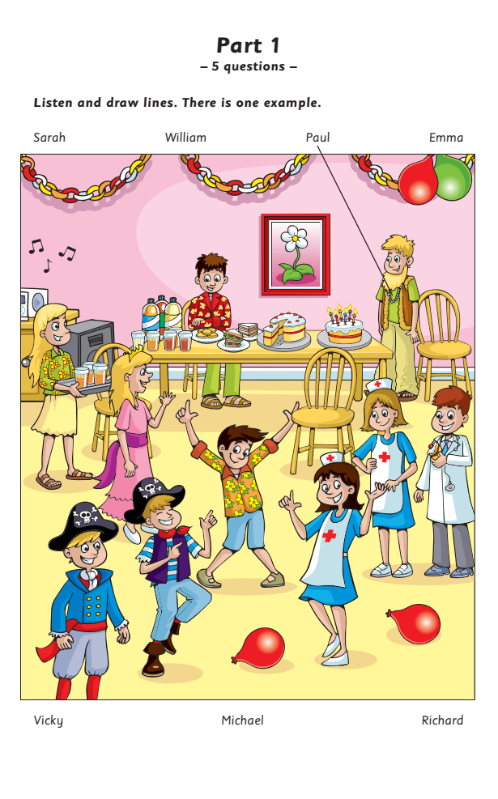
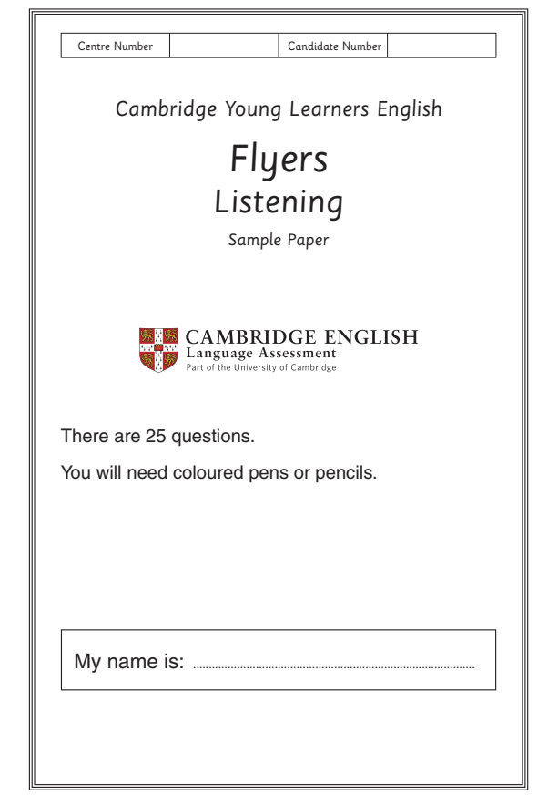

Slide 14
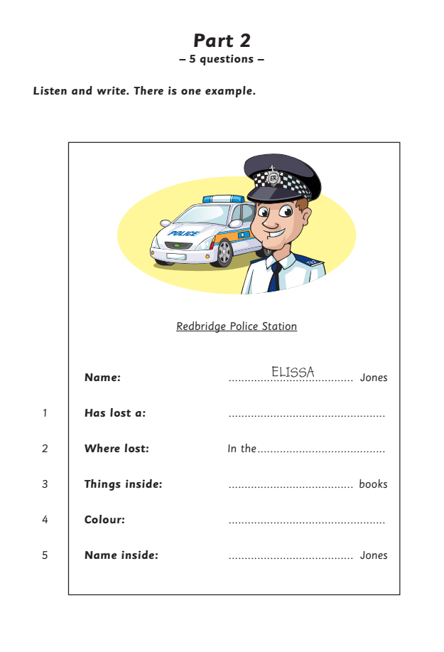
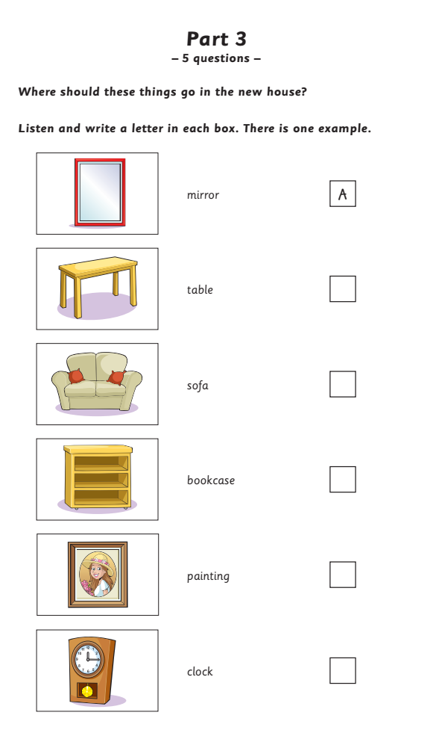

Slide 15
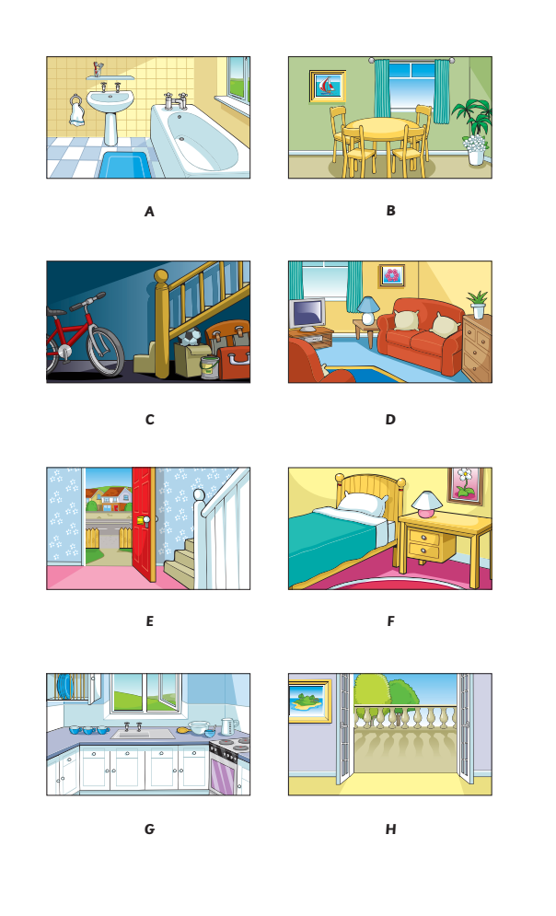
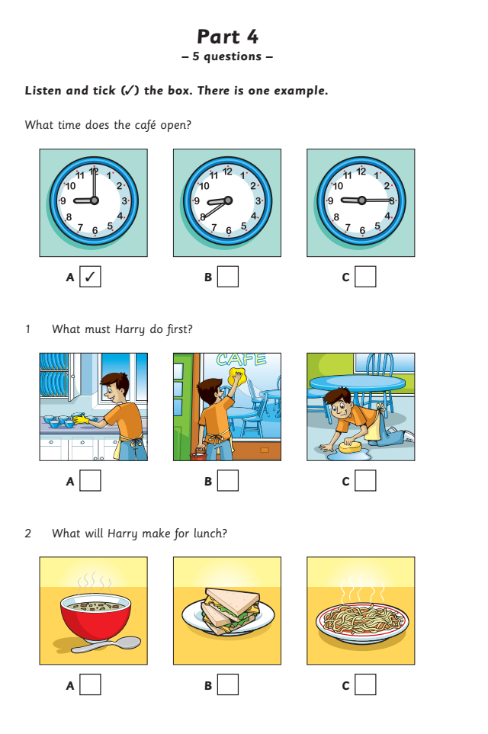

Slide 16
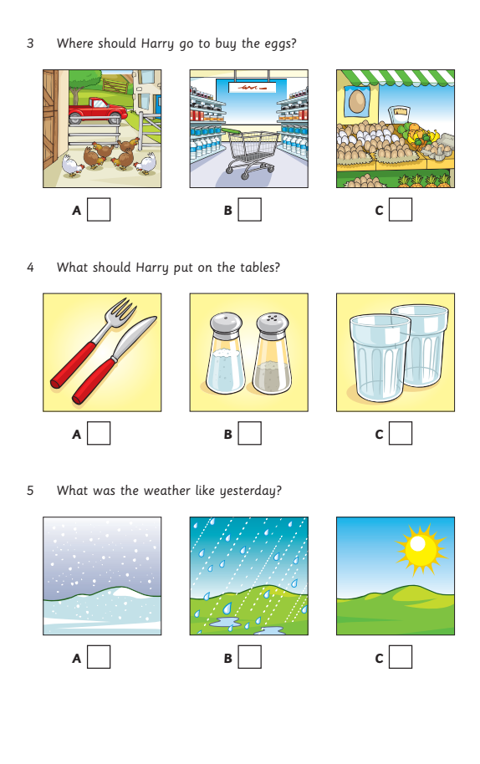
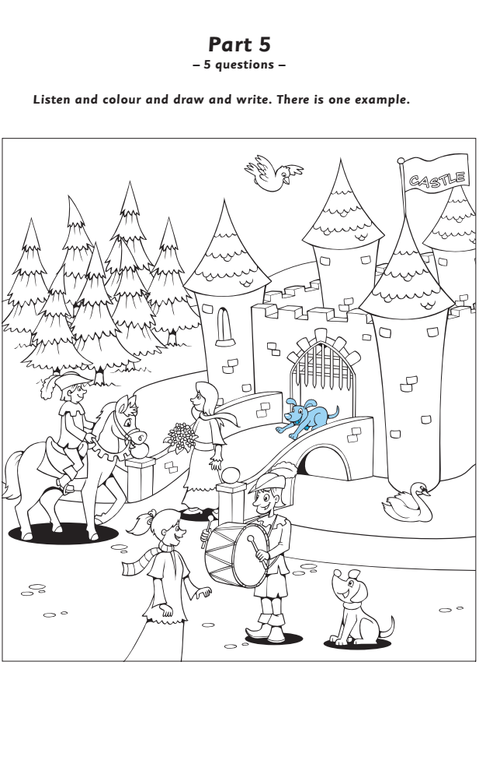

Slide 17
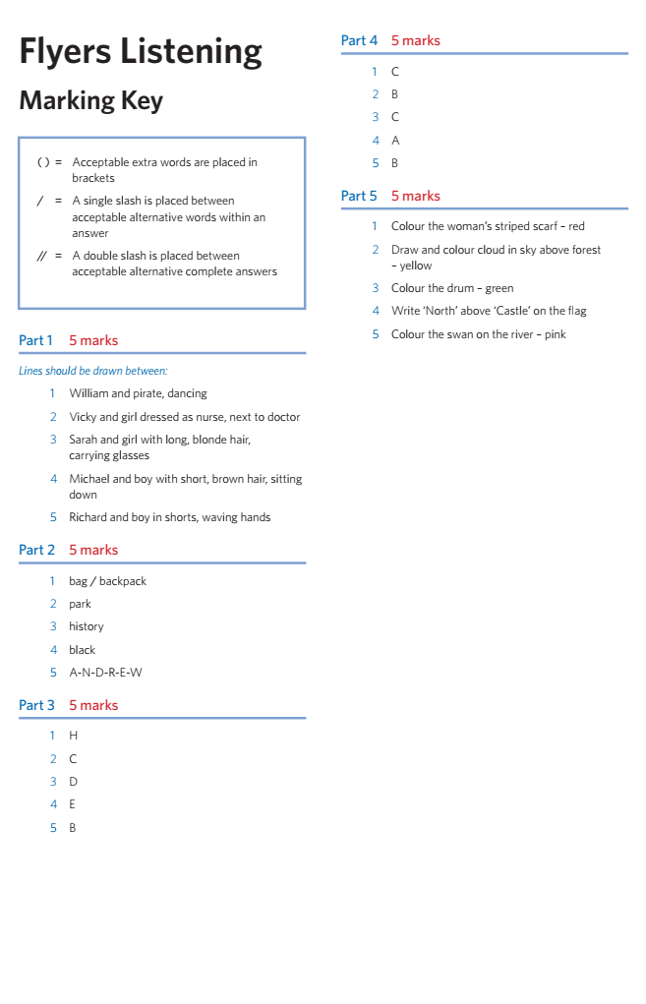
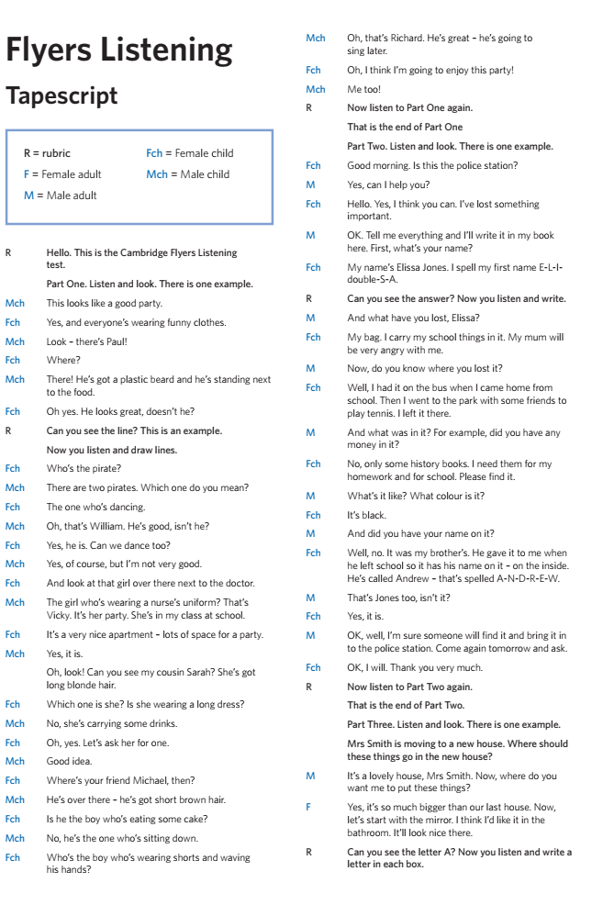

Slide 18
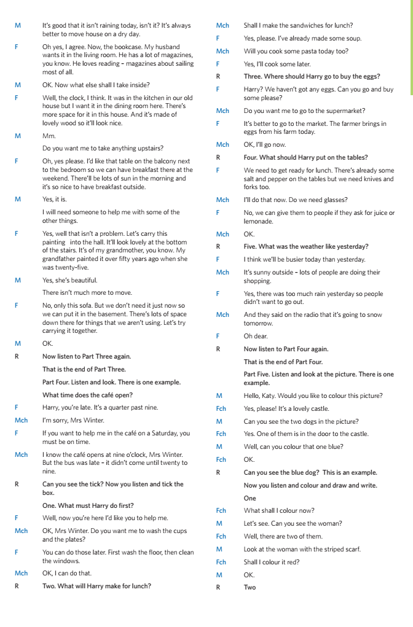
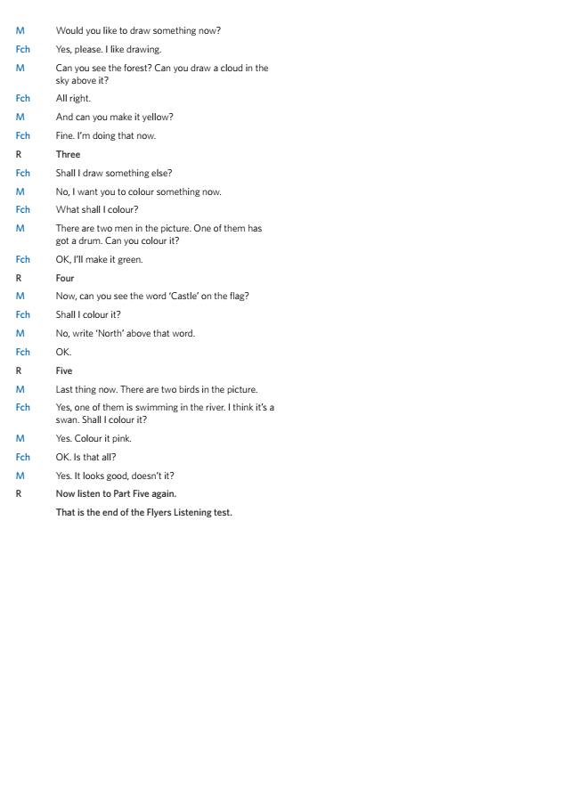

Slide 19
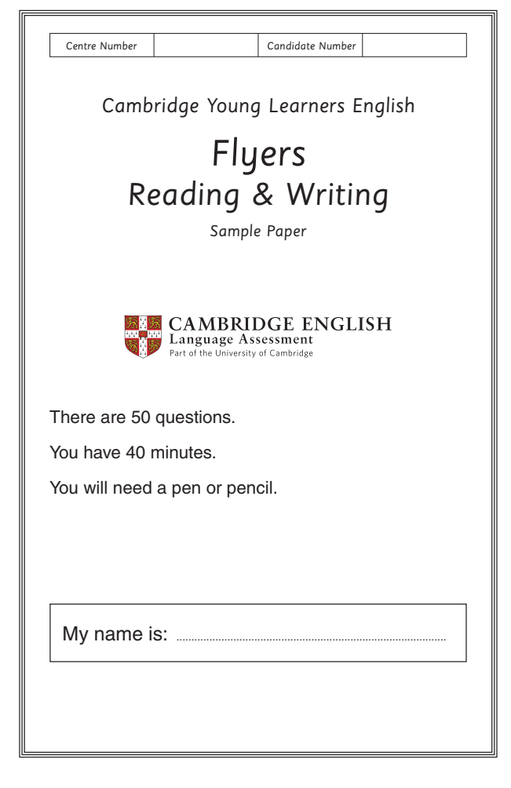
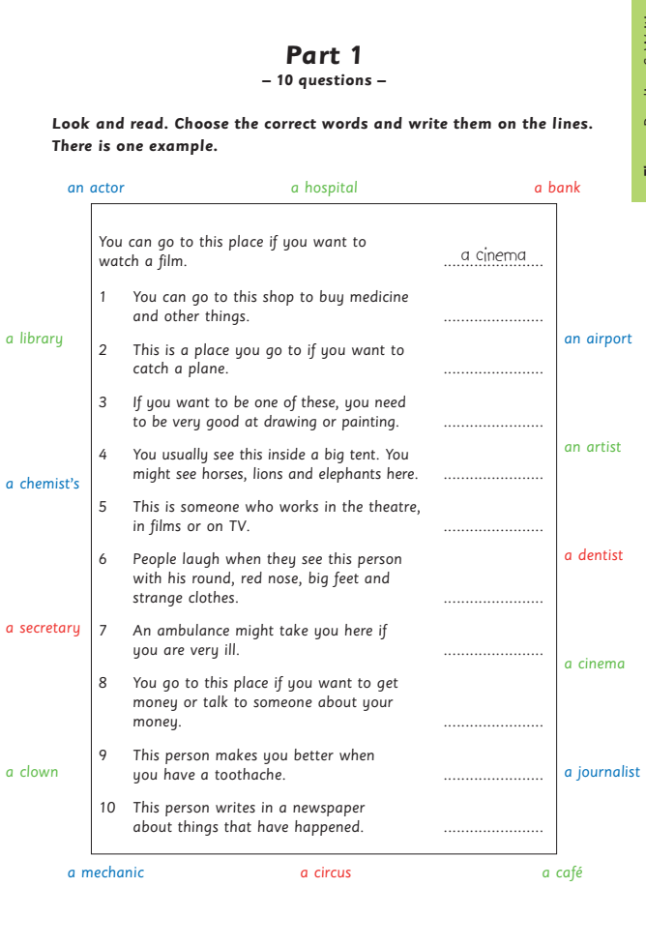

Slide 20
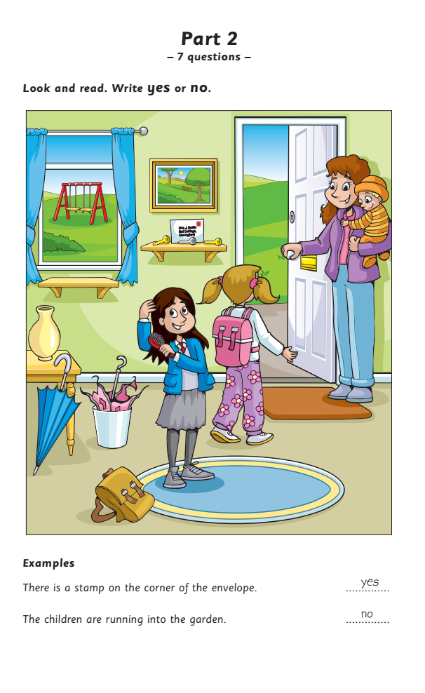
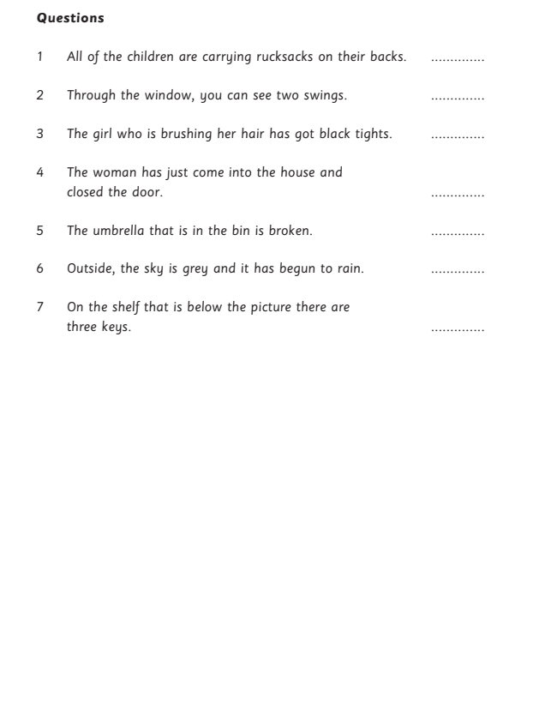

Slide 21
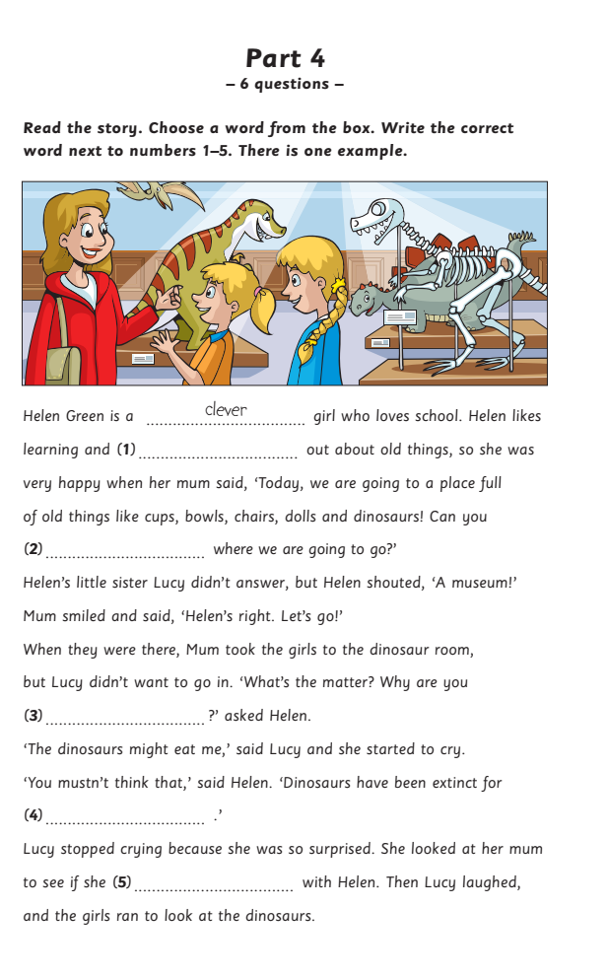
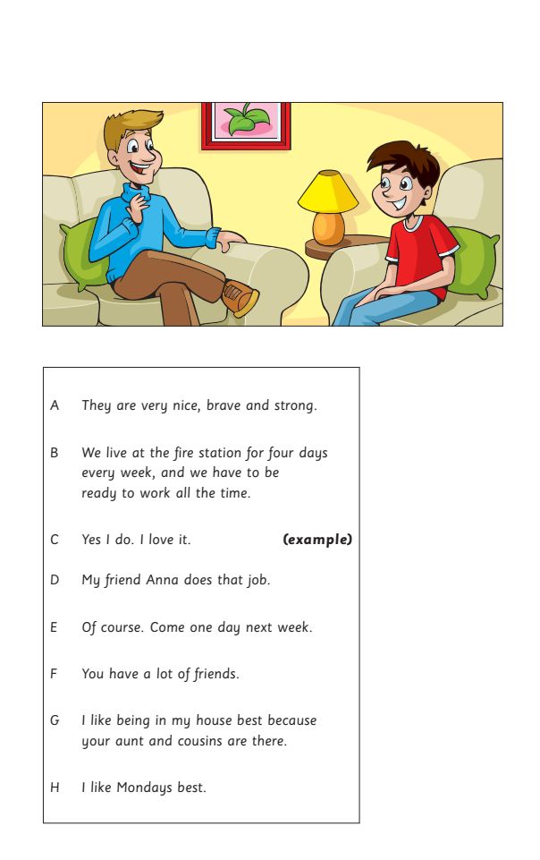

Slide 22
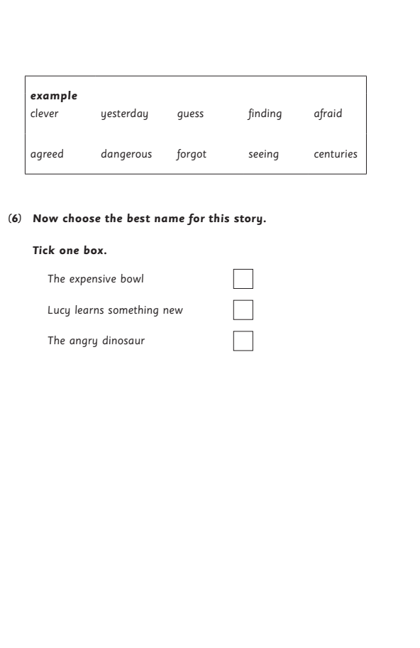
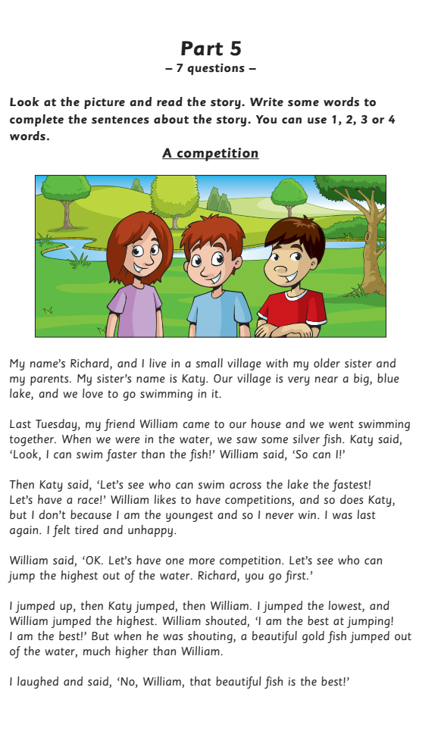

Slide 23
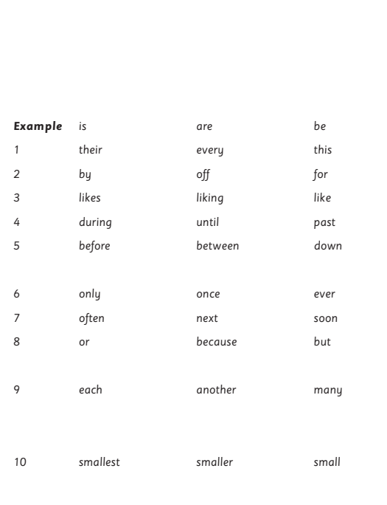
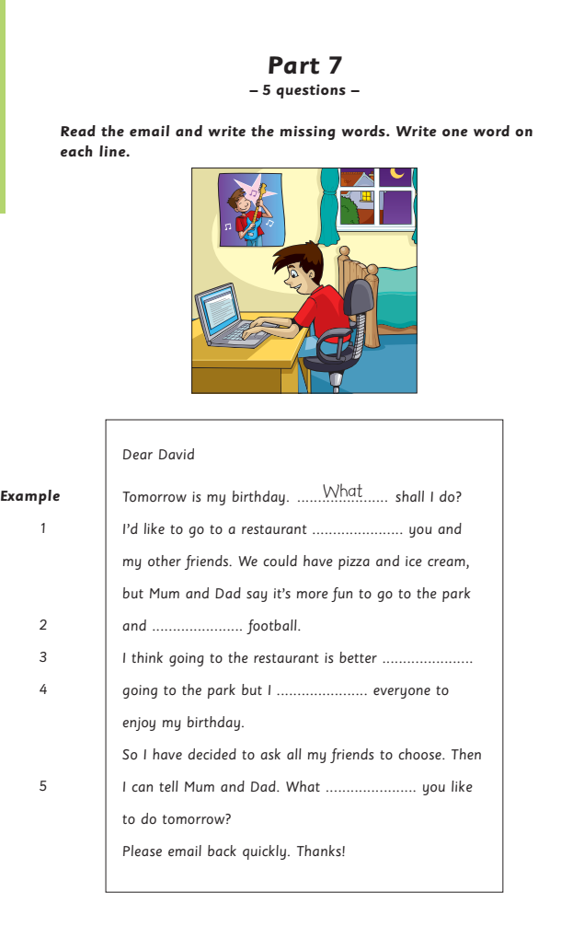

Slide 24
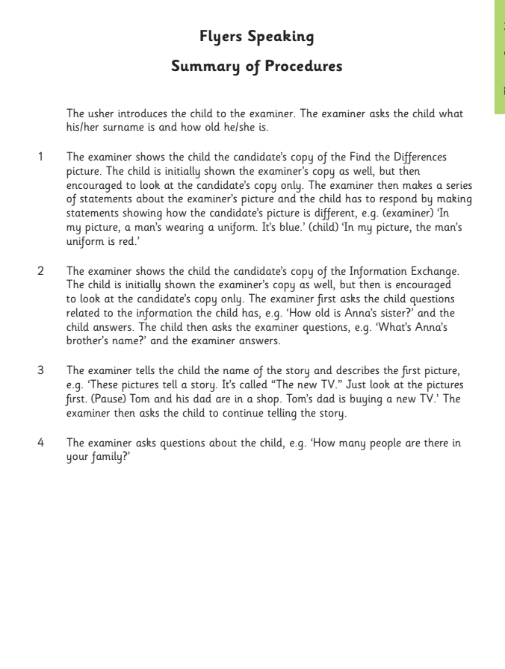
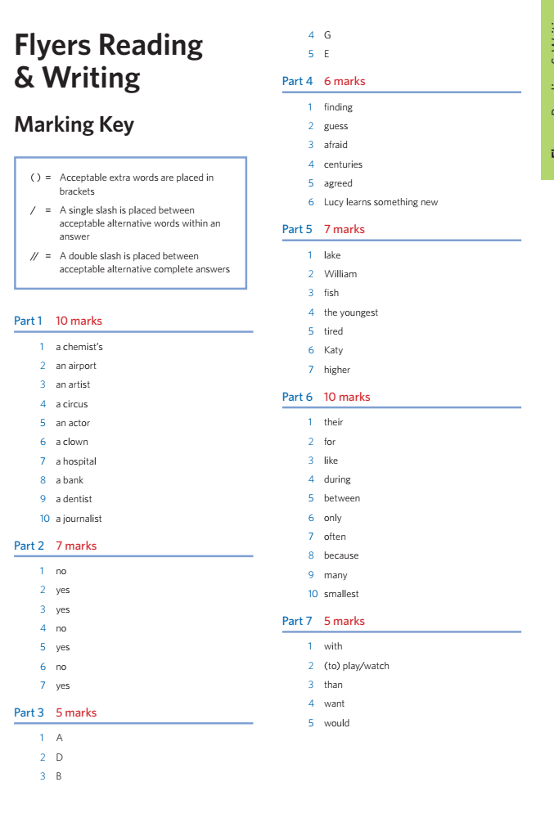

Slide 25
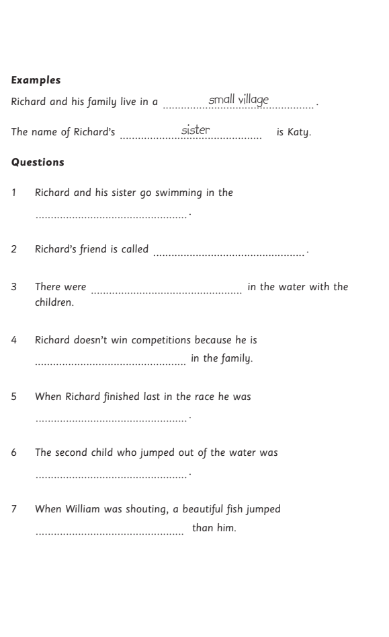
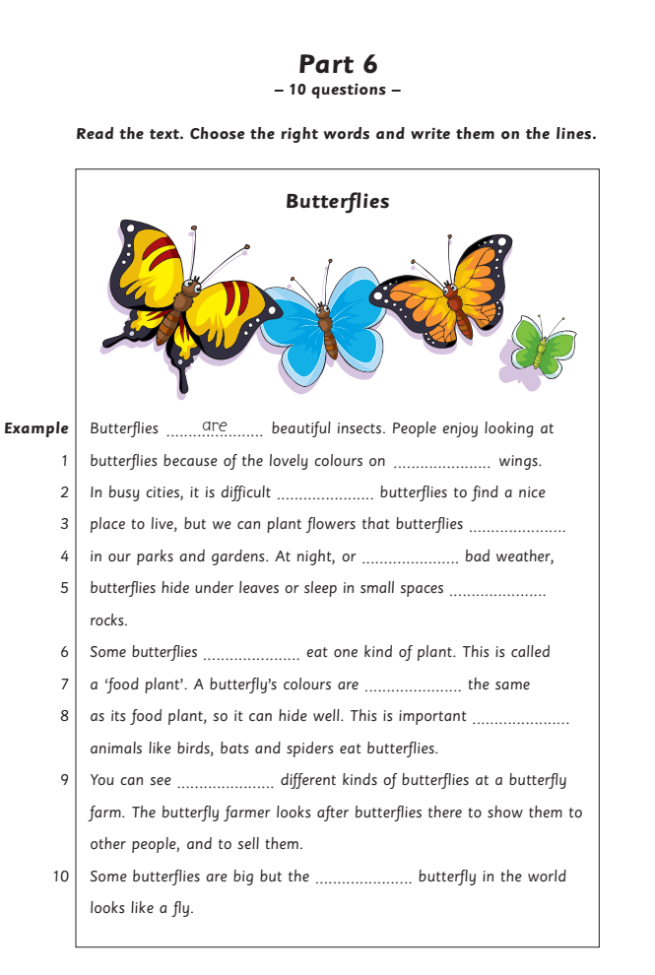

Slide 26
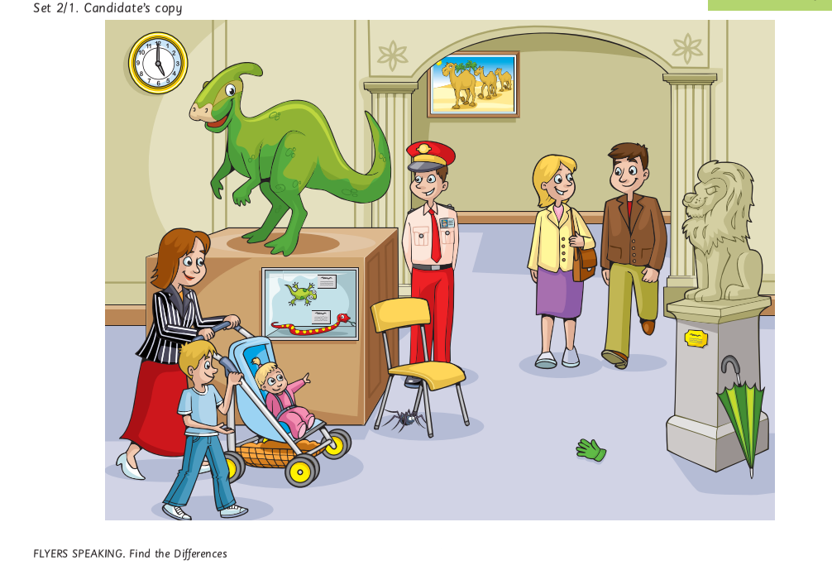

Slide 27
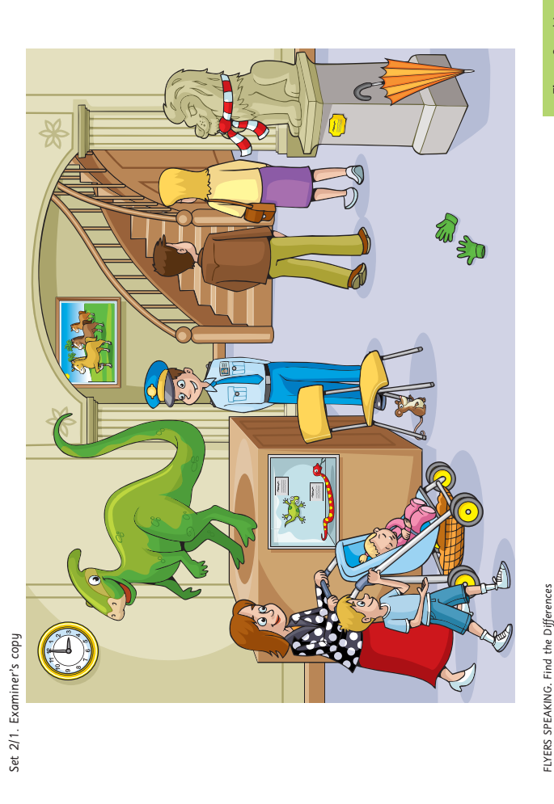

Slide 28
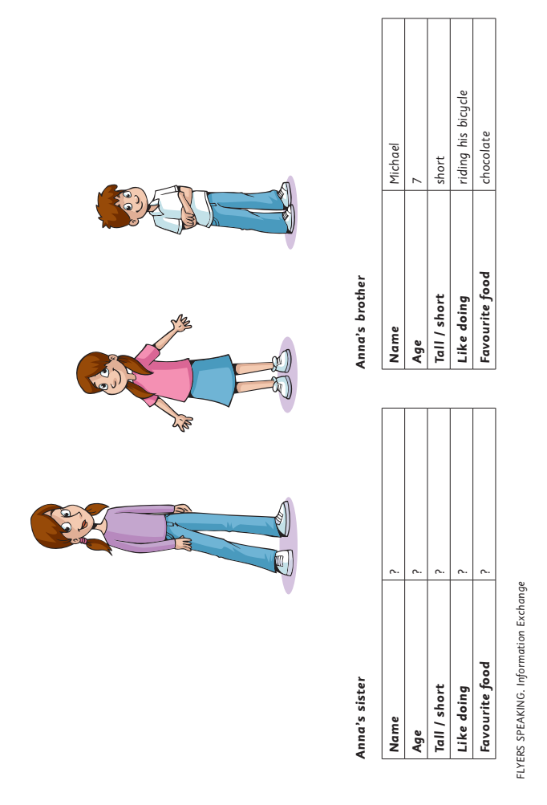

Slide 29
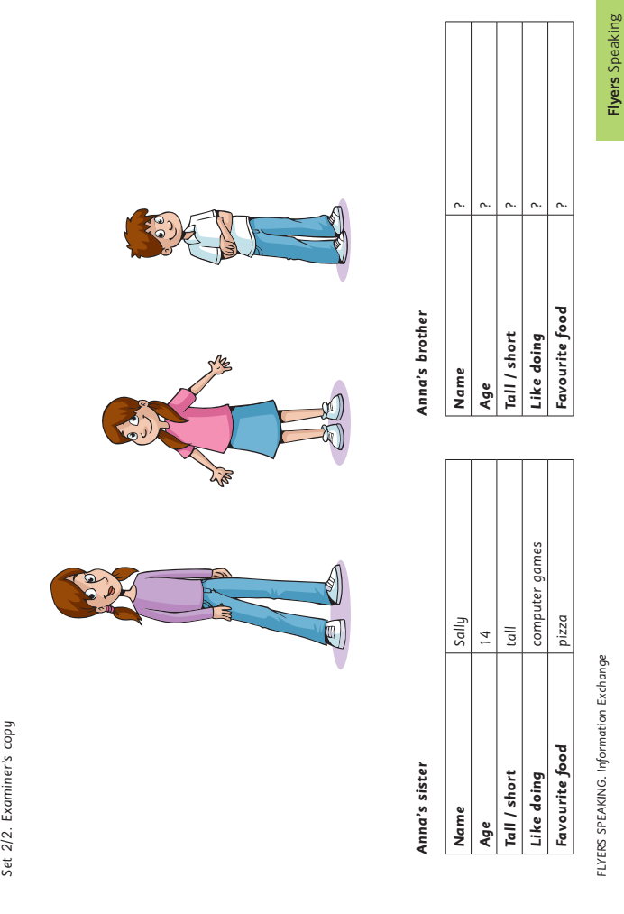

Slide 30


