Slide 1
Media literacy in English classroom
Saodat Erkaboyeva

Slide 2
Objectives:
Discuss how to use media literacy in the English classroom
Explore the topics and tasks for developing English through media literacy
Try strategies to create activities using media

Slide 3
Discussion
What is Media Literacy?
How media literacy enhances language skills

Slide 4
Newspaper? Television? Blog? Magazine? Social media site?
Media literacy is an expanded conceptualization of literacy that includes the ability to access and analyze media messages, as well as create, reflect and take action—using the power of information and communication—to make a difference in the world.
Fake news doesn’t come from news media

Slide 5
Reading an article
https://www.hmhco.com/blog/4-tips-to-teach-students-news-media-literacy-in-the-digital-age

Slide 6
How to teach media literacy
1. Tell students to avoid instantly reacting to a headline.
2. Explain to students that older may be wiser.
3. Teach them that biased does not mean false.
4. Portray media as a best friend of the people.

Slide 7
Topics and Products?
Creating blogs/posts: Blogs, posts
Thank you notes/Compliments: Brochures/booklets
My favorite writer/singer/dish: Digital storytelling/Recording a short clips
Earth Day: Photo competition, posting a photo with team for protecting Nature

Slide 8
Project “Reciting Robert Frost’s poem and posting it online”
Find a poem by Robert Frost and learn it by heart. (It can be the students’ homework)
Record/take a video of yourself while reciting that poem by InShot or Video maker programs. (Introduce yourself, tell some facts about Robert Frost and a poem you are going to read.
Ex: Hello, I’m Durdona, Andijan Access student. I want to tell you a poem By Robert Frost. It’s …… )
Post your work in your group’s telegram group or padlet
Read other students’ work and comment on their posts

Slide 9
Some Examples
Creating reels/blogs/posts
Digital story and posting it
Audio recording
Technovation Girls- a pitch video https://youtu.be/0WgngR7LgAk?feature=shared

Slide 10
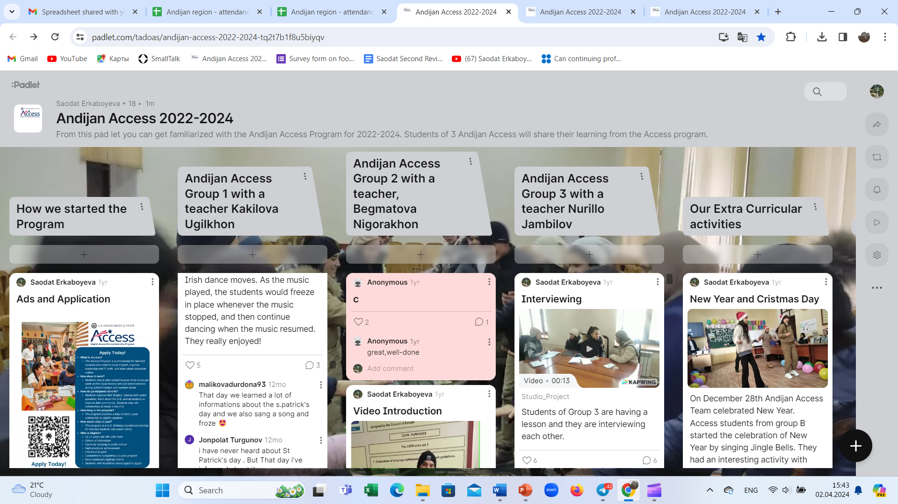
Creating electronic portfolio using padlet.com

Slide 11
Suggestions for further use:
Google site/Padlet/
Google Apps-Form/Sheet/Calendar
Participants work in Groups
Group A – Google Form task
Group B- Google Sheet task
Group C- Google Calendar task

Slide 12

Example
Find a poem by Robert Frost and learn it by heart. (It can be the students’ homework)
Record/take a video of yourself while reciting that poem by InShot or Video maker programs. (Introduce yourself, tell some facts about Robert Frost and a poem you are going to read.
Ex: Hello, I’m Durdona, Andijan Access student. I want to tell you a poem By Robert Frost. It’s …… )
Post your work in your group’s telegram group or padlet
Read other students’ work and comment on their posts

Slide 13
References
https://padlet.com/tadoas/andijan-access-2022-2024-tq2t7b1f8u5biyqv
https://sites.google.com/view/andijanaccess2021/group-b
https://t.me/access_ac

