Slide 1
4 Cs
Aim:
Discuss the practical strategies to integrate the 4 Cs into their English lessons.
Apply the 4 Cs framework and explain its relevance in English teaching

Slide 2
OPENING DISCUSSION
"What skills do students need to succeed in the 21st century?"

Slide 3
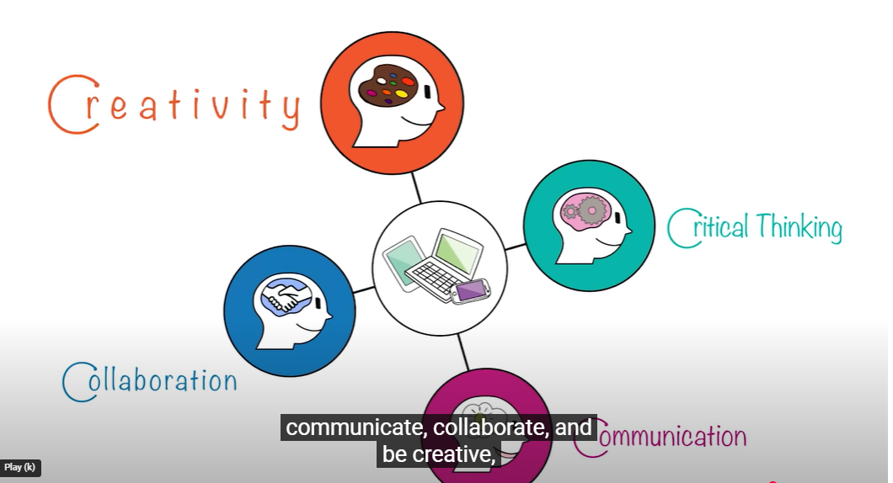
https://www.youtube.com/watch?v=QrEEVZa3f98

Slide 4
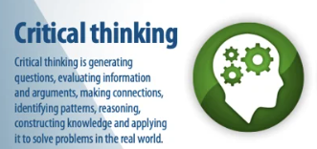

Slide 5
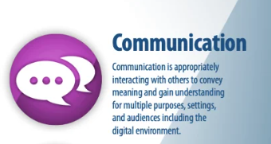

Slide 6
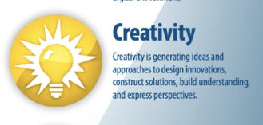

Slide 7


Slide 8


Slide 9
Group Work
Give a name to your team
Find out who…. Can 😔 /Be good at 😊 /Be bad at ☹
Use Ex: Can you ….? Are you good/bad at…?
Names | Speak 5 languages | Draw pics | Cook a delicious meal
1
2
3
4
Group Report
Our team’s name is________. There are ______ members in our team.
_______ of us can _____________________________________.
_______ of us are good at _______________________________.
_______ of us are bad at ________________________________.
_______ of us are not good at ____________________________.
_______ of us are not bad at _____________________________.
Only ___ member is (not) ________ at _________________________.

Slide 10
References :
http://teachesl.pbworks.com. Teaching grammar.
Taras.A. (2013). Teaching communicative grammar:including a practical approach to teaching future notion.
Rama ,J.L, Augullo,G.L. (2012) The role of grammar teaching: Form communicative approaches to the common European framework of reference for languages.
The 2025 Grammar Guide by EnglishGrammar.org

Slide 11
Test
What is a primary goal of using collaboration in language learning?
a) Encouraging individual competition among students.
b) Reducing the number of group activities in class.
c) Developing teamwork and problem-solving skills.
d) Ensuring students complete tasks independently.

Slide 12
True/False
Critical thinking involves analyzing and evaluating information rather than memorizing it.

Slide 13
Effective communication in English classes can be achieved by:
a) Focusing solely on grammar rules.
b) Using role-plays and real-world scenarios for practice.
c) Avoiding interaction among students.
d) Conducting only written assessments.

Slide 14
True/False
Creativity in English teaching is limited to artistic activities like drawing or acting.

